Slide 1
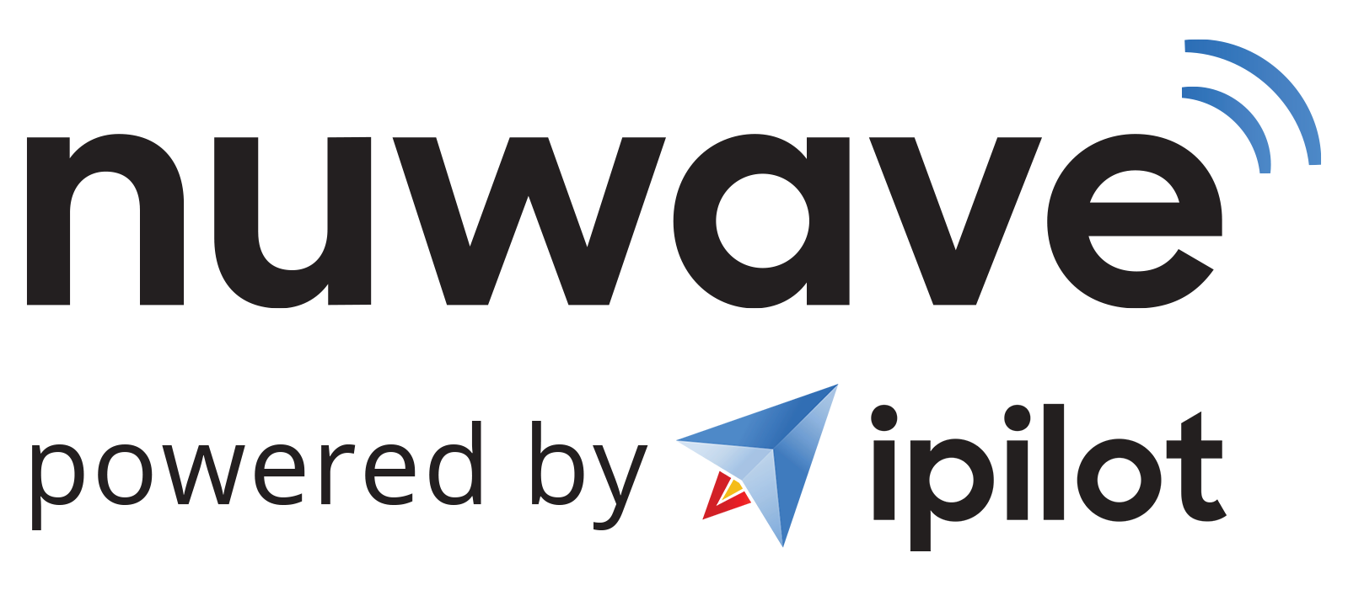
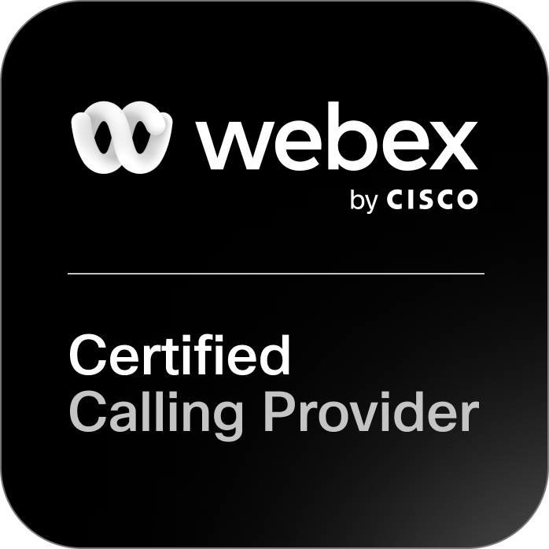
SEPTEMBER 2023
NUWAVE’s VALUE PROPOSITION
CISCO’s ENABLEMENT PROVIDER PROGRAM
CLOUD CONNECT FOR WEBEX
www.nuwave.com
©2023 NuWave Communications or its licensors. All Rights Reserved. Third-party marks and logos displayed are the trademarks of their respective owners.

Slide 2
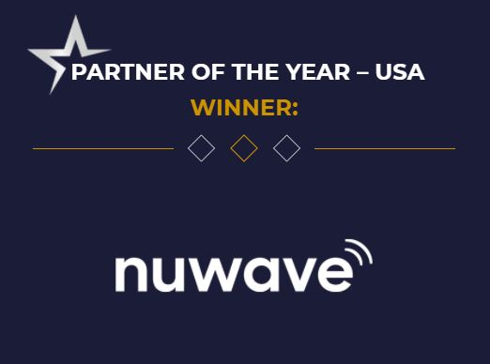
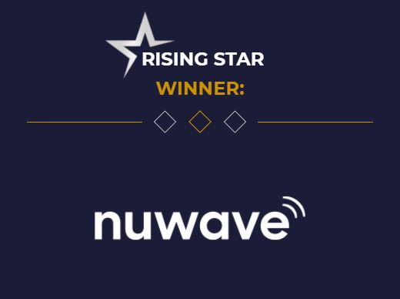
NUWAVE Communications
PROVEN EXPERIENCE & RELIABILITY
As a Global Voice Carrier, NUWAVE has 20+ years of experience delivering communications services to customers worldwide and developed iPILOT - an Award-Winning SaaS Platform to manage and deploy NUWAVE’s hosted Cloud Connect for Webex Calling
CLOUD CONNECT FOR WEBEX
Carrier-Grade, Certified Calling Provider of Cloud Connect for Webex Calling
SMS
Send Texts, images and more with Business Texting
FAX INTEGRATIONS
On-Prem and Cloud Fax Integrations for your Cloud Voice Solution
iPILOT AUTOMATION
First in class, voice automation, provisioning, and management platform
CALL RECORDING
Compliance Call Recording with AI integrations and scripting
ANALOG INTEGRATION
Whether you have on-prem or analog devices, iPILOT has solutions for your needs
Why NUWAVE?
No Onsite Hardware, reduced CAPEX. Only an Internet Connection is required.
1 to 1 Connect with Cloud Connect for Webex Calling
Deployment Support with dedicated Porting and Engineering Specialists
Reduce Deployment Costs and Timelines by using the iPILOT Self-Service Portal
A Few of Our Partners:
nuwave.com NuWave Communications Confidential and Proprietary
www.nuwave.com
©2023 NuWave Communications or its licensors. All Rights Reserved. Third-party marks and logos displayed are the trademarks of their respective owners.

Slide 3
An Innovative Solution for
for Connecting Voice Services
Problem for Carriers:
NUWAVE Solution.
Conventional Cost
$$$
NUWAVE Solution
Opex Opportunity
Cloud Connect for Webex Calling is costly to setup and scale.
Only pay for what you use. NUWAVE’s platform allows for maximum scalability.
Lack of Resources
Complete Automation
Sparsity of engineering & capable resources.
Zero-touch, fully elastic automated platform with a full Deploy, Manage, Support life-cycle enablement.
Time to Market
Months to Years
Time to Market
Enabled in 30 Days
Delayed time to market in setup & complexity.
Deployment of your Cloud Connect for Webex Calling Offer in days, not months or years.
Conventional Cost
Global Reach & Scale
Carrier dependent on network infrastructure that can be limited in regional or global reach.
Geo Redundant Global Network Coverage through Certified Calling Providers and partnered Carriers through NUWAVE
www.nuwave.com
©2023 NuWave Communications or its licensors. All Rights Reserved. Third-party marks and logos displayed are the trademarks of their respective owners.

Slide 4
Ready for Market
Microsoft Teams Global Voice Platform Built for Rapid Consumption
BYOC Platform
Application Marketplace
Expand your reach by adding Global service and connecting to our geo-redundant, carrier-grade network
Enhance your Cloud Calling Service with additional feature adds like SMS, Cloud fax, and Call Compliance
Introduce your Voice Service to the Growing Cloud Connect for Webex Calling and Cloud Calling Marketplace.
White Label Ready - Platform Full customer life-cycle management
All-in-one platform to manage your resellers, partners, and customers
Zero touch provisioning for your customers and resellers
Quote to Cash – Easily provide a link for your customers and resellers to start a POC with your service
Easily Configure your own Cloud Connect for Webex Calling Offer
3rd Party applications like SMS, Cloud fax, Compliance Recording and more...
www.nuwave.com
©2023 NuWave Communications or its licensors. All Rights Reserved. Third-party marks and logos displayed are the trademarks of their respective owners.

Slide 5
^{NA Location A}
^{Las Vegas, NV}
^{Europe Location A}
^{London England}
^{Europe Location B}
^{Frankfurt Germany}
^{APAC Location A}
^{China Hong Kong}
Easily Connect
Your Services to
Our Global Marketplace
^{Global Network}
^{North America}
^{Europe}
^{South America}
^{Oceania}
^{Africa}
^{Asia Pacific}
^{NA Location B}
^{Ashburn, VA}
^{Brazil (2 pops)}
^{Sao Paulo}
^{Africa (2 pops)}
^{Cape Town}
^{APAC Location B}
^{Australia Location B}
^{Singapore}
^{Australia Location A}
^{Sydney}
www.nuwave.com
©2022 NuWave Communications or its licensors. All Rights Reserved.
Third-party marks and logos displayed are the trademarks of their respective owners.

Slide 6
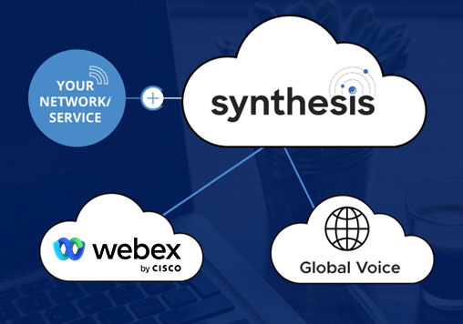
Cloud Connect for Webex Calling
Built for Carriers
Cloud Connect for Webex Calling delivers PSTN connectivity through a world-class selection of Certified Calling Providers.
NUWAVE has completed a rigorous certification process to ensure end-to-end compatibility with Webex Calling. This in-depth process ensures that customers receive consistently high-quality and reliable services from our Certified Calling Providers. Customers can be confident that our Certified Calling Providers will support a wide range of Webex deployments, including basic calling scenarios, enterprise-scale Dedicated Instance migrations, and demanding, high volume Webex Contact Center deployments.
SYNTHESIS Solves for:
API Integrations
Global Connectivity
Automation/Management
Cloud Connect Integration
White-Label Ready Solution
www.nuwave.com
©2023 NuWave Communications or its licensors. All Rights Reserved. Third-party marks and logos displayed are the trademarks of their respective owners.

Slide 7
The Business Case for Today’s Market
Single UI Management
Single Pane of Glass
No easy way to connect your current service provider or to your existing Cloud architecture that enables your remote work. This results in a company managing a variety of different services while trying to tie them together, which causes higher overhead costs, operational complexity, and long response times from providers.
Faster time to Revenue
Because of the complexity of provisioning, enabling your Cloud Network can take a long time to implement, sometimes having to wait weeks or months before getting your service or users up and running.
Reduced Overhead & Cost of Administration
Connecting your Voice Network to your Cloud Office can have a complex onboarding and provisioning process, which requires extensive coding knowledge and a team of Engineers to be able to provision new users, assign new numbers or make changes to your current network.
Faster Revenue Streams
Zero-Touch Provisioning
www.nuwave.com
©2023 NuWave Communications or its licensors. All Rights Reserved. Third-party marks and logos displayed are the trademarks of their respective owners.

Slide 8
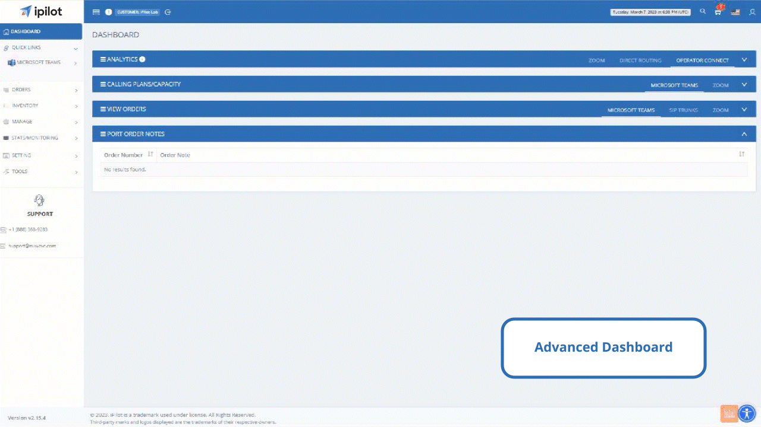
An Advanced Webex
Management
Platform
Easy to manage,
White-label ready
iPILOT is a cloud-based platform that delivers comprehensive provisioning and lifecycle management capabilities for Webex users.
iPILOT enables efficient deployment of Webex & SIP through quick provisioning, capacity management and analytics for enterprises, carriers, and cloud service providers
www.nuwave.com
©2023 NuWave Communications or its licensors. All Rights Reserved. Third-party marks and logos displayed are the trademarks of their respective owners.

Slide 9
Migration
Planning
Automation
Analytics
Migration tools
Migration
Migration Tools
Easy to use Migration tools for Migrating from or to different systems.
Legacy PBX to Microsoft Teams
From Direct Routing to Operator Connect
Operator Connect to Direct Routing
Planning
Automation
Analytics
www.nuwave.com
©2023 NuWave Communications or its licensors. All Rights Reserved. Third-party marks and logos displayed are the trademarks of their respective owners.

Slide 10
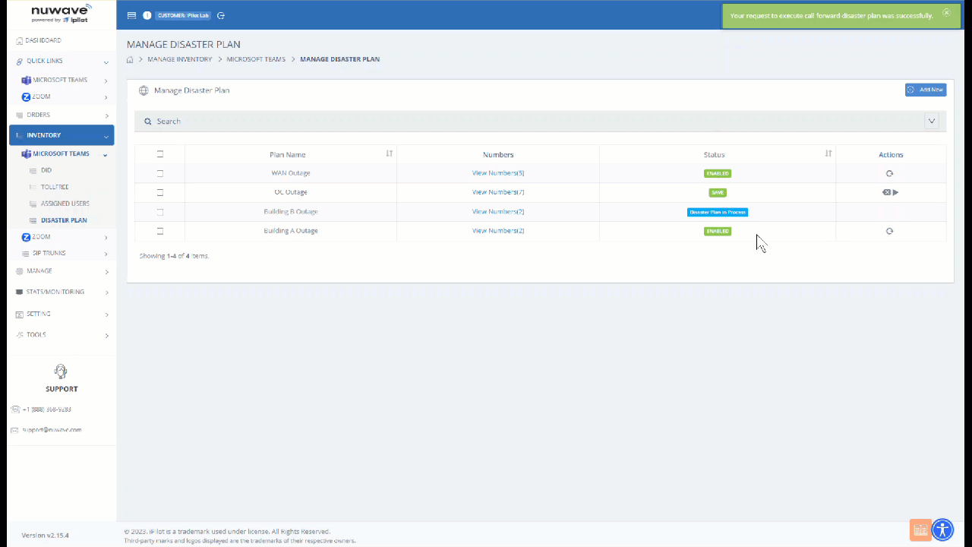
Migration
Planning
Automation
Analytics
Disaster Planning:
Migration
Planning
Versatile Disaster Plans with flexibility to mitigate multiple forms of outages for customers. Built in PBX Assessment tools to efficiently plan your migrations.
PBX Assessment
Disaster Planning
Account Provisioning Staging
Phone Number Self-Service Porting
Planning
Automation
Analytics
www.nuwave.com
©2023 NuWave Communications or its licensors. All Rights Reserved. Third-party marks and logos displayed are the trademarks of their respective owners.

Slide 11
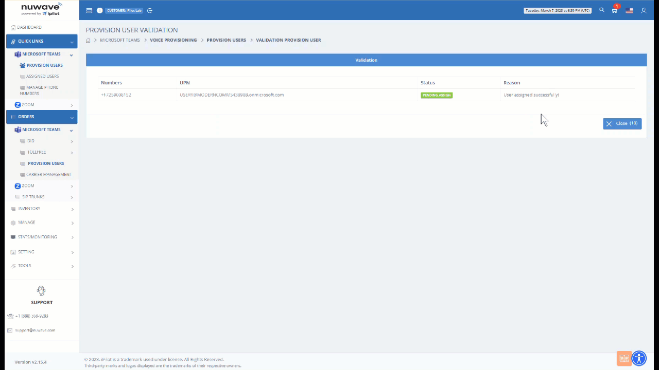
Migration
Planning
Automation
Analytics
Provisioning:
Migration
Automation
End-to-end communications management platform that is unmatched in the industry with its high level of service availability and support.
Number activation
Direct Routing Tenant Configuration
Bulk Phone Number Assignment
MACD for Teams Voice​
Carrier Management
iPILOT Controlled Operator Connect
Phone Number Assignment
Planning
Automation
Analytics
www.nuwave.com
©2023 NuWave Communications or its licensors. All Rights Reserved. Third-party marks and logos displayed are the trademarks of their respective owners.

Slide 12
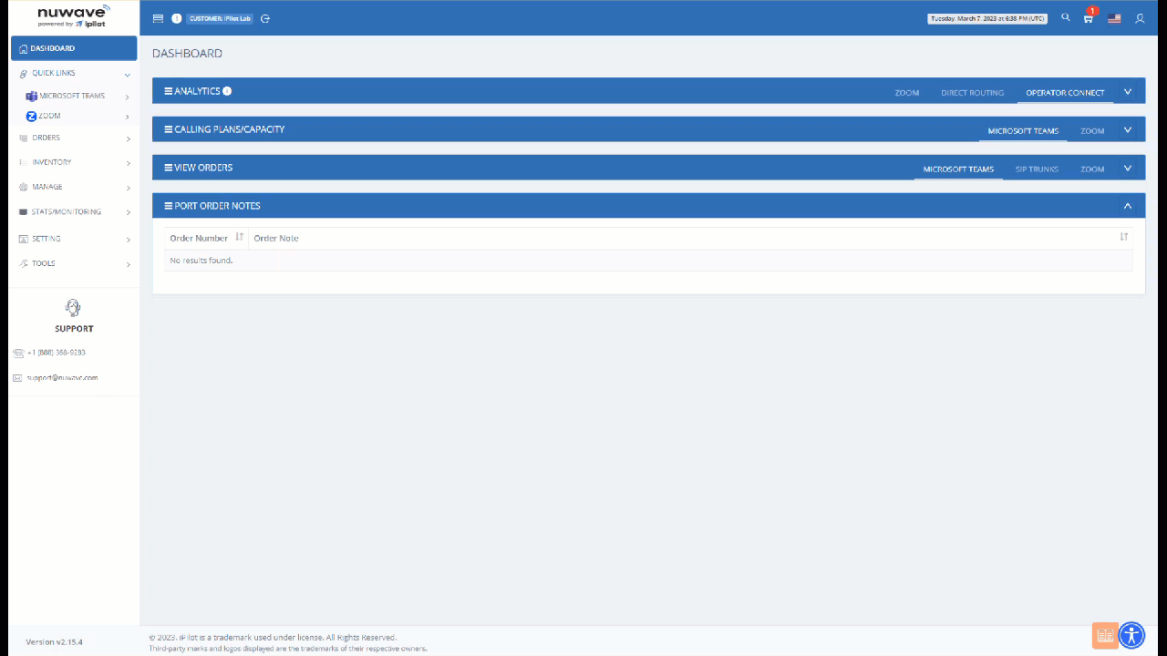
Migration
Planning
Automation
Analytics
Analytics:
Migration
Analytics
Full-service analytics and reporting features, including:
Quality of service reports
Call logs
Call Data Records
Call quality dashboard
Error Status reporting​
Planning
Automation
Analytics
www.nuwave.com
©2023 NuWave Communications or its licensors. All Rights Reserved. Third-party marks and logos displayed are the trademarks of their respective owners.

Slide 13
Enable Free Trials
In only a few minutes, your customers can self-enable a specified, time-limited POC of your Cloud Connect for Webex Calling Offer.
Enable your customers and partners with the most industry disrupting tool in the market for Webex Calling.
Proof of Concept
What you can include in your Free Trial:
iPILOT Benefits
Set-Up : Automated Provisioning including Self-Activation
Duration: Free Trial periods can be customized as needed
Carriers’ Voice: Ability to enable Free Trials (Immediate Trunk & DID Availability)
Built for the Global Market: Multi-Lingual User Interface
Business Continuity: Extensive learning and knowledge base to leverage lower cost resources
Carrier Partner Voice Network
iPILOT’s first in its class automated provisioning platform
Unified, Simple, and fast Cloud Connect for Webex Calling Experience
iPILOT delivers the best unified calling experience for Webex Calling in the market today.
Unified Solution
Single Pane of Glass Management
Global Compliance
Enabled in Minutes
nuwave.com NuWave Communications Confidential and Proprietary
www.nuwave.com
Sales@nuwave.com
©2023 NuWave Communications or its licensors. All Rights Reserved. Third-party marks and logos displayed are the trademarks of their respective owners.

Slide 14
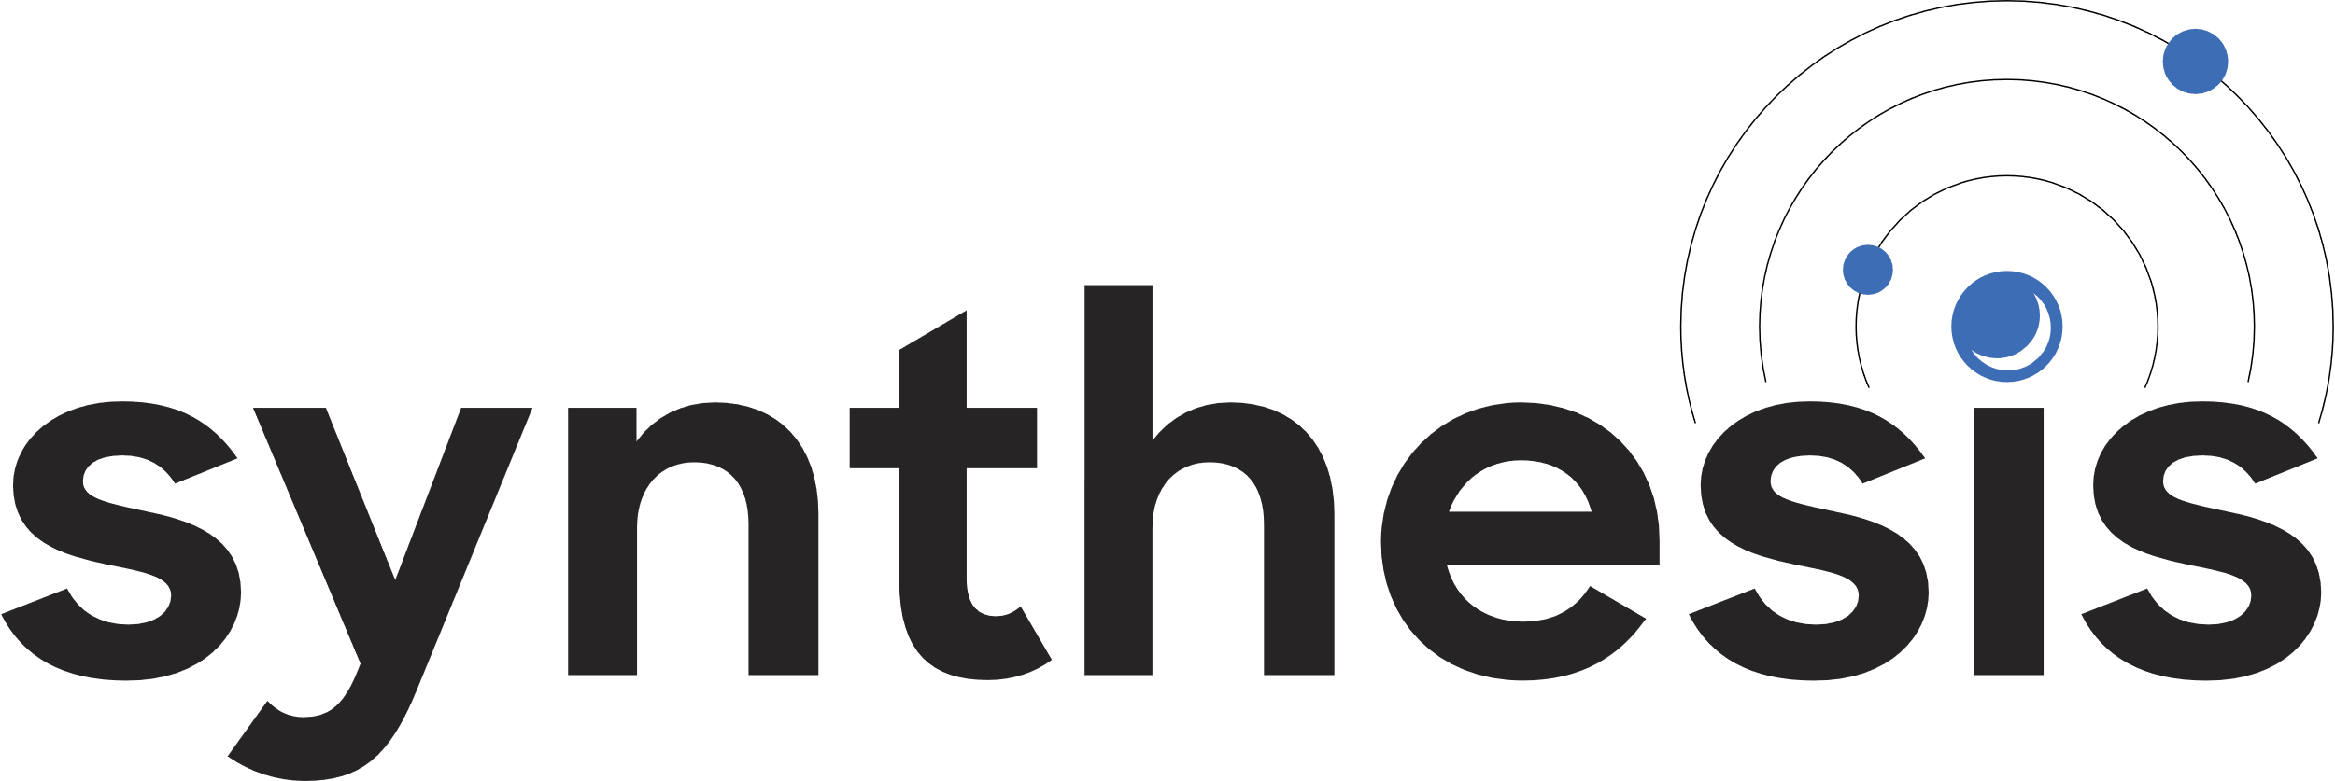
Disaster Planning and Automation
On-Demand DID Management & Orchestration
Fraud, Hacker, DDoS and STIR SHAKEN Tools
BSI Certified for
ISO 27001, ISO 27017, ISO 27018, ISO 27701
Geo-Redundant, Global Coverage
iPILOT offers a cloud platform as a service (CPaaS) to support the entire Webex Calling lifecycle.
OSS/BSS
Integration
API
Integration
Operator
Network
SIP
SIP
The SYNTHESIS platform is created to quickly enable Carrier networks looking to offer their own Cloud Connect for Webex Calling Services.
Advanced Reporting & Analytics
24/7 Support
White-label Ready Platform
Dedicated Roadmap for Partner Success
Billing
Management
www.nuwave.com
©2023 NuWave Communications or its licensors. All Rights Reserved. Third-party marks and logos displayed are the trademarks of their respective owners.

Slide 15
How NUWAVE's ISO Certifications Benefits NUWAVE Partners
NUWAVE has recently increased its security posture by adding 3 more ISO certifications to its existing ISO 27001 status. ISO 27017, 271018, and 27701 certifications are now also in place for meeting the NEW Industry standard for protecting Enterprise Cloud services that NUWAVE takes to market to customers and enables through its Partners.
NUWAVE has chosen to implement the most trusted global security certification, audited by independent bodies to ensure compliance with strict standards of practice, fostering trust and assurance.
the risk of cyberattacks…
by processing customer data securely according to best practices.
process and strategies…
by creating repeatable systems of accountable measurement.
system and business resiliency…
by designing and testing business continuity management.
to customer requirements…
by recording customer requirements and auditing compliance.
policy to comply with complex regulations…
by documenting regulatory obligation and auditing compliance.
trust, confidence and assurance…
because NUWAVE adheres to an international standard with measurable accountability to partners and customers.
Reduces
Improves
Increases
Aligns
Structures
Establishes
www.nuwave.com
©2023 NuWave Communications or its licensors. All Rights Reserved. Third-party marks and logos displayed are the trademarks of their respective owners.

Slide 16
Thankyou
www.nuwave.com
Sales@nuwave.com
©2023 NuWave Communications or its licensors. All Rights Reserved. Third-party marks and logos displayed are the trademarks of their respective owners.

