Slide 1
Direct Routing
Direct Routing Benefits
Because of the complex architecture that goes along with Direct Routing, customers are able to custom build their network with robust features while taking advantage of their existing hybrid, on-prem SBC, or Cloud network setups.
Customers can work directly with their local telco to enable calling features for Microsoft Teams users while keeping their existing investment into their calling infrastructure (PBXs, Call Centers, and Analog Telephony Adaptors (ATA)).
Highly
Customizable
Leverage Existing Infrastructure
Reasons to choose Direct Routing:
Highly Customizable
Can use existing PSTN infrastructure
Phase your migration by department, office, or number range
Existing PBX co-existence (Must first migrate from legacy telephony systems)
Available Globally
Bring your own Carrier Service
Local PSTN survivability via SBA
Bring your Own Carrier

Slide 2
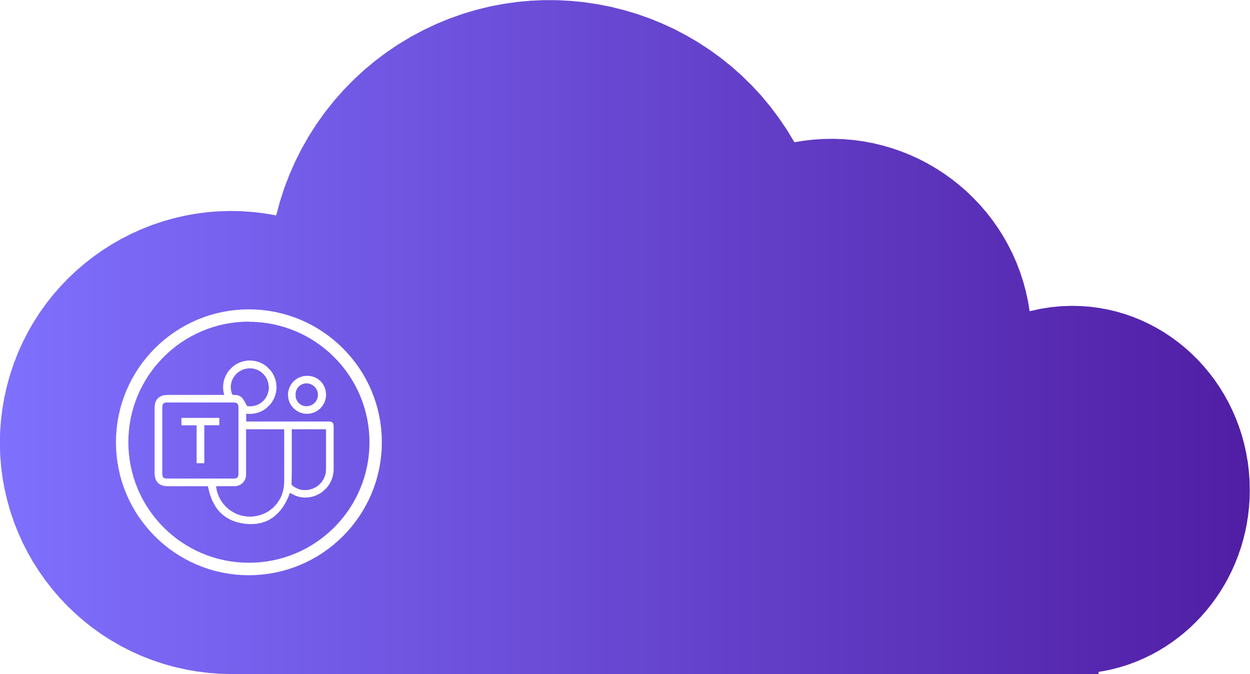
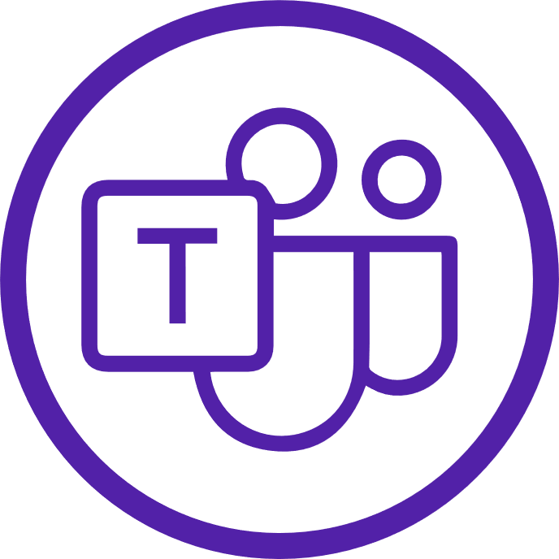
Direct Routing
WFH/ Remote
Teams Users
Teams Cloud
Services
INTERNET
INTERNET
PSTN
Teams “Connect” Model
Hosted Contact Center
INTERNET
SIP ATA
Teams Certified SBC
Organization Premises
Legacy PBX Integration
Teams Users
Analog Devices

Slide 3
Direct Routing As a Service
3rd Party Hosted SBCs
Direct Routing (DRaaS)
Teams Certified SBCs require knowledge workers and maintenance that make them difficult to maintain. Because of this, many organizations choose to go the Direct Routing As a Service, or SBCs As a Service Route.
This allows for an organization to outsource their certified SBCs in order to integrate into the Teams Cloud calling ecosystem without the heavy lift of maintenance and certification.
Managed Infrastructure
Reasons to choose DRaaS / SBCaaS:
Highly Customizable Solutions
3rd Party Hosted SBCs
Phase your migration by department, office, or DDI range
Existing PBX co-existence (Must first migrate from legacy telephony systems)
Global Service through Microsoft Partners
Local PSTN survivability via SBA
Migrate in Phases

Slide 4
Direct Routing As a Service
WFH/ Remote
Teams Users
SBCaaS / DRaaS Provider Cloud
Teams Cloud
Services
Number Blocks
INTERNET
INTERNET
PSTN
Teams Certified SBC
3rd Party Addons
INTERNET
INTERNET
Teams “Connect” Model
Hosted Contact Center
Organization Premises
Legacy PBX Integration
SIP ATA
Analog Devices
Teams Users

