Slide 1
Operator Connect
Benefits of Operator Connect:
Operator Connect allows you to manage all your numbers and users directly inside of the Microsoft Teams Admin Center. You can request a relationship directly from the Teams Admin Center, which allows you to see and assign numbers provided to you by NUWAVE.
Still to come:
Because Operator Connect is still in its infancy stages, it currently has limited functionality and features that may be required for larger enterprise customers who may want to have more control over their network. As features get added, NUWAVE can help you bridge the gap with Direct Routing while OC grows.
Fully Managed Solution
Direct Connection Through Microsoft Azure Peering Services
Currently not supported:
Common Area Phones
Meeting Rooms
ATA support for Analog devices (i.e., Paging)
Reasons to choose Operator Connect:
Simplified Deployment Process
Fast Setup, setup in minutes
Phone Number management from Teams Admin Center
Fully Cloud Based Solution, No equipment required, Fully Managed Solution
1:1 network connection for enhanced resilience through MAPS
Manage Numbers from Multiple Operators in the Teams Admin Center
Can Coexist with Direct Routing and Calling Plans in the same tenant
Teams Admin Center Management

Slide 2
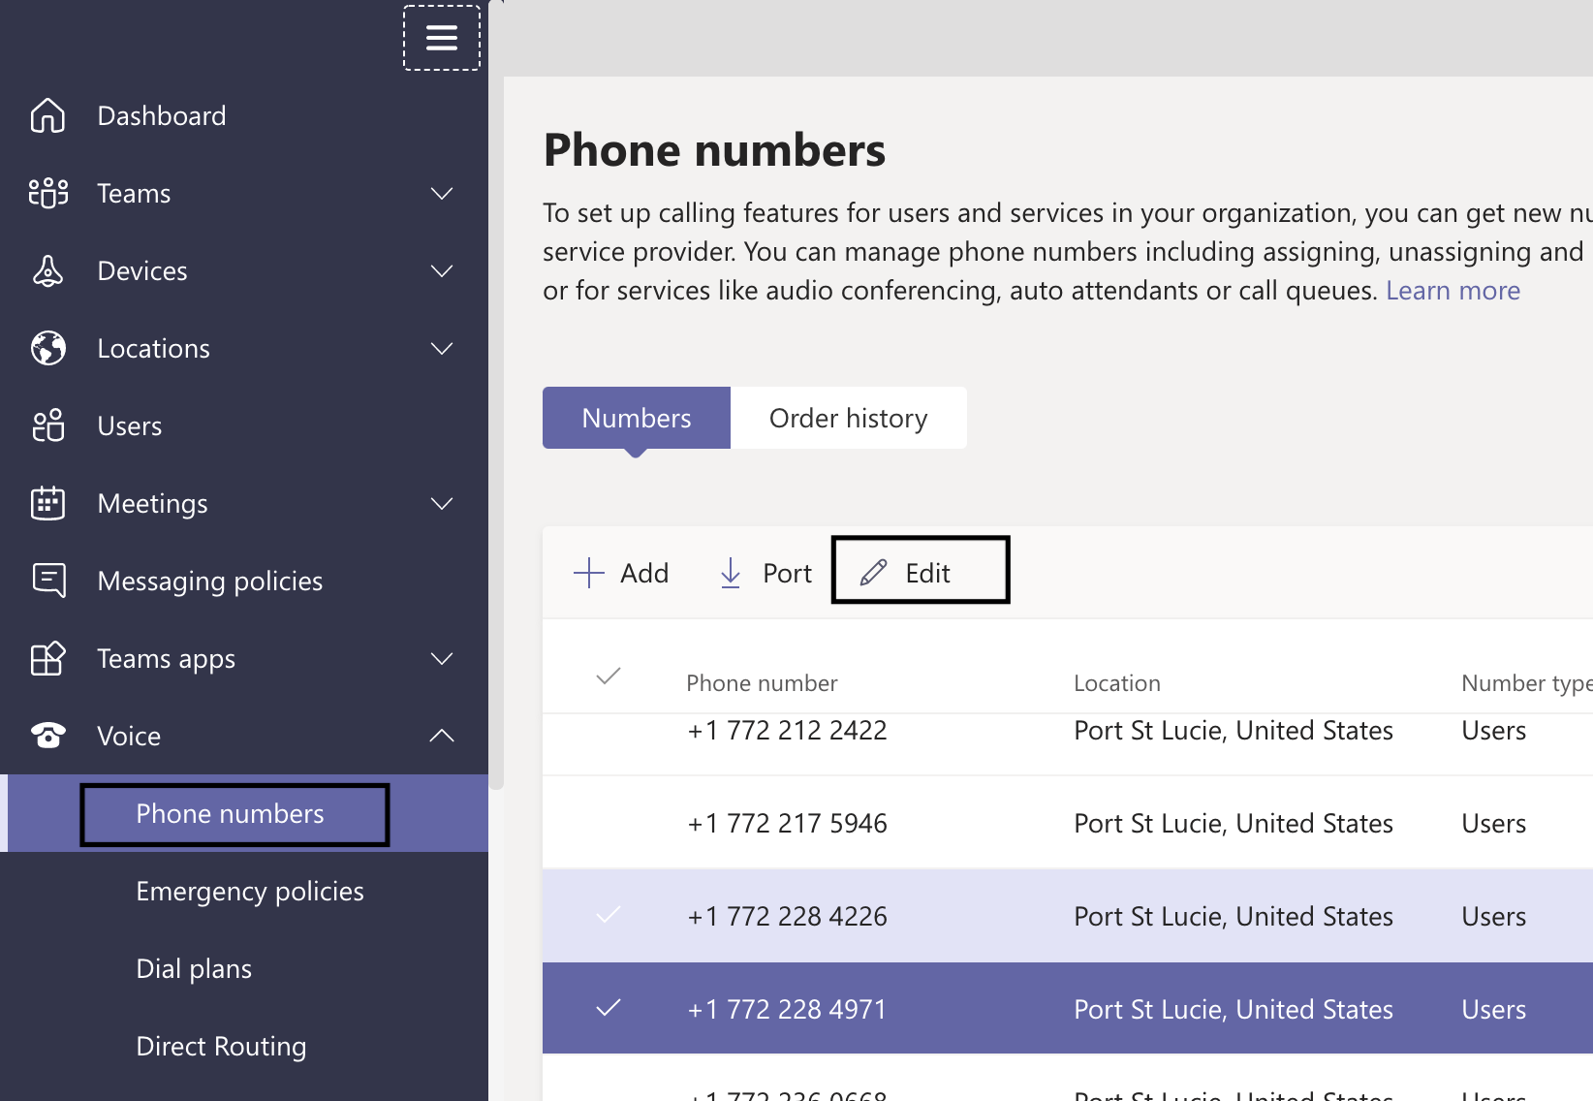
Operator Connect
Building now for the future
Number Provisioning:
Manage all your numbers and users directly inside of the Microsoft Teams Admin Center.
Self Service Management of Phone Numbers and users through the Teams Admin Portal
DID inventory management and assignment
nuwave
nuwave
nuwave

Slide 3
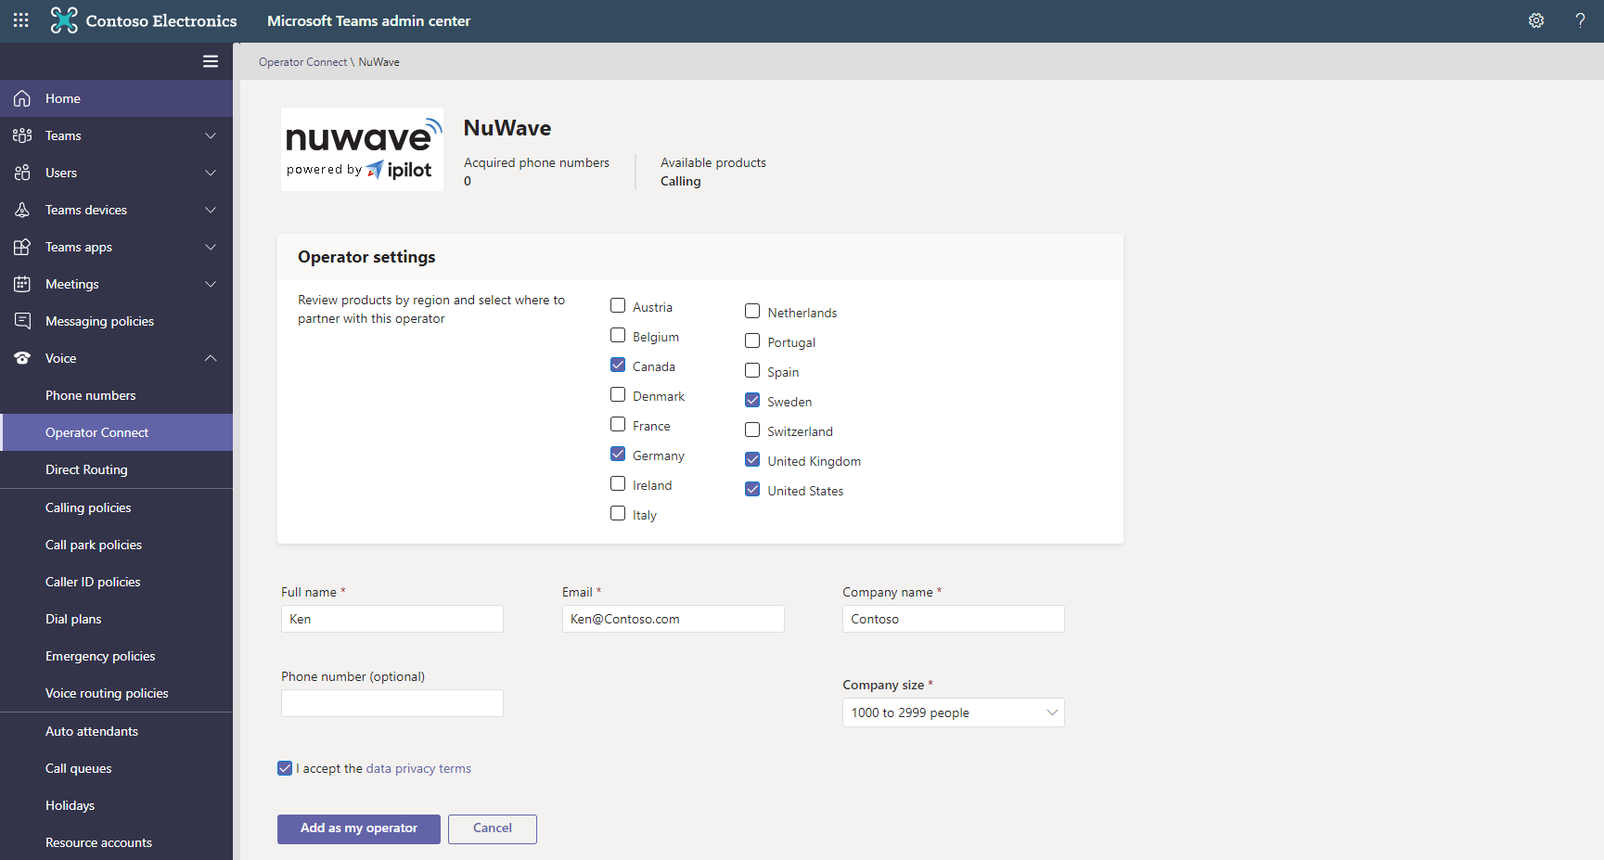
Operator Connect
Operator Management
Operator Management:
You can request a relationship directly from the Teams Admin Center, which will also allow you to see and assign numbers provided to you by Operators.
Building now for the future
For the Customer:
Easy access to Operators for Calling Management
Easily segregate access by Region/Geography/Calling areas per Operator
For the Operator:
No special permissions such as delegated admin permissions to manage Calling Services
Single Point of Contact information for customer updates & maintenance

Slide 4
Operator Connect
Numbers
Number Provisioning:
Manage all your numbers and users directly inside of the Microsoft Teams Admin Center.
Number Provisioning
For the Customer:
Self Service Management of Phone Numbers and users through the Teams Admin Portal
DID inventory management and assignment
For the Operator:
Numbers show up in the Teams Admin Center
Simple MACD changes through the portal

Slide 5
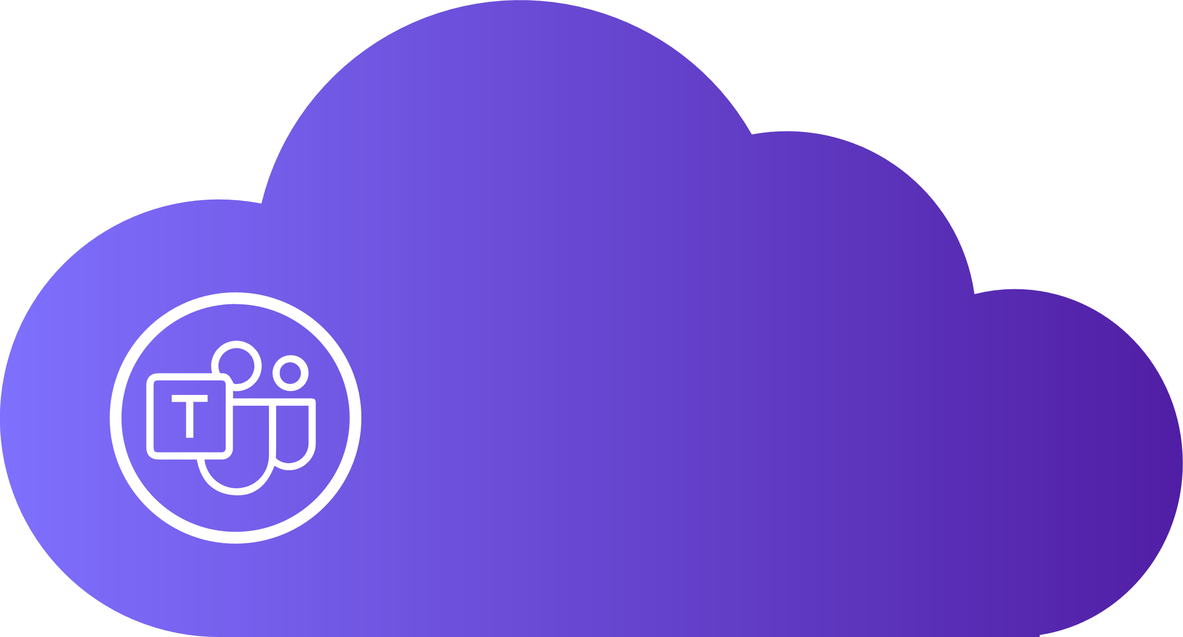
Operator Connect
WFH/ Remote
Teams Users
Operator Connect Provider
Teams Cloud
Services
Number Blocks
INTERNET
PSTN
Teams Certified SBC
3rd Party Addons
Global Direct Peering –
Microsoft Azure Peering Services
INTERNET
INTERNET
Teams “Connect” Model
Hosted Contact Center
Organization Premises
Legacy PBX Integration
SIP ATA
Analog Devices
Teams Users

Slide 6
Operator Connect
Interconnection
API
Operator Portal
INITIAL CONFIG/ FALLBACK
Customer 1
Teams Users
AUTOMATION
Direct Peering – MAPS
Microsoft Azure Peering Services
Microsoft
Teams
Customer 2
PSTN
For the Customer:
Easy access to Operators for Calling Management
Easily segregate access by Region/Geography/Calling areas per Operator
For the Operator:
No special permissions such as delegated admin permissions to manage Calling Services
Single Point of Contact information for customer updates & maintenance
End to End QOS from Client, to Microsoft's Cloud, and through the Operators Cloud
Offer High Level SLA to the customer
Direct Peering through MAPS
Provisioning APIs and Portal

Slide 7
The Difference between Microsoft Operator Connect and Direct Routing
 | Operator Connect | Direct Routing
Program Type | Programmatic Approach to Operator Provided Calling | Not a Program. Core Functionality.
Interconnection | Microsoft Azure Peering Service (MAPS) for Voice Dedicated Portal/APIs for Trunk Setup and validation | TLS/SRTP over internet Carrier Tenant for setting up super trunk Some Customer configuration required or delegated specifically
Number Provisioning | Provisioning through APIs to facilitate automation | None, need customer account or “admin on behalf” for executing PowerShell commands
Teams Admin Center | Presence in the portal, customer can select the Operator for number provisioning / management, or assignment | None
Customer Experience | Number visualized in the portal as Operator numbers IT Admin can assign numbers to users directly from the portal | IT Admin or Operator needs to assign number through PowerShell IT Admin or Operator needs to create/assign Voice Policies
Data Sharing | CDR/CQD (QoS)/SLA data provided to Operators through API’s Joint CDR for customers reporting | CDR/CQD data can be retrieved tenant by tenant using delegated access
Support / SLA | Operator Tier 1 Support; Operator-Microsoft Model in place Product Change Management and updates channel Back-to-back SLA in place between Microsoft and Operator | Operator Tier 1 Support Escalations through M365 Support or Premier Support No Back-to-back SLA in place
Management | Dedicated Management capabilities in Operator Portal/API (at GA) | Delegated Admin or Teams RBAC Access required from Customer
Total Cost of Ownership | “As a Service” model delivered by the Operator | SBC owned and operated by the Customer or Hosted/Managed by the Operator

Slide 8
Today’s Snapshot Comparison
Features | Direct Routing | Operator Connect | MSFT Calling Plans
Native Teams Call Routing | ü | ü | ü
Shared Trunk / Call Path sharing plans | ü | ü | NA
eFax & traditional fax solutions | ü | ü | NA
SMS Integrations | ü | ü | NA
Dynamic Emergency Calling | Optional | Included | Included
Direct Connection to Microsoft via MAPS | ONLY through iPILOT Galaxy | Only Approved Carriers | NA
Carrier Level Forwarding | ONLY through iPILOT | ONLY through iPILOT | NA
Disaster Plans | ONLY through iPILOT | ONLY through iPILOT | NA
Automated Bulk Provisioning | ONLY through iPILOT | ONLY through iPILOT | Bulk via PowerShell
Converting DIDs between User & Service Number | ONLY through iPILOT | ONLY through iPILOT | via MSFT Ticket
Managing multiple carrier DIDs in 1 Portal | ONLY through iPILOT | ONLY through iPILOT | NA
Manage Direct Routing & Operator Connect DIDs in 1 Portal | ONLY through iPILOT | ONLY through iPILOT | NA
Department level access for phone number management | ONLY through iPILOT | ONLY through iPILOT | NA
Extension Dialing | ONLY through iPILOT | ONLY through iPILOT | NA

