Slide 1




Overview
www.nuwave.com
©2023 NuWave Communications or its licensors. All Rights Reserved. Third-party marks and logos displayed are the trademarks of their respective owners.

Slide 2
The New Hybrid Work Model
The need for a unified experience
The Surge in
Video Meetings
Video conf surged in 2020
In 2021, video conferencing became the must-have UC&C application to support hybrid work. video is a more proven way to collaborate effectively
Unified Communications & Collaboration (UC&C) Voice and Messaging
Demands to offer multiple means of communicating—calls, voice, video meetings, and enterprise-grade messaging.
Team Collaboration as the New Dial Tone in the COVID Era
Many front-line worker jobs depend on team collaboration. Remote knowledge workers rely heavily on team collaboration tools
Intelligent UC&C Platform
with team collaboration
Transition from analog features to true intelligent communications platforms. Seamless Modalities and Full Functionality
www.nuwave.com
©2023 NuWave Communications or its licensors. All Rights Reserved. Third-party marks and logos displayed are the trademarks of their respective owners.
2
Notes:
Video conferencing surged to the forefront in 2020, as people around the globe had to work from home. In 2021, video conferencing became the must-have UC&C application to support hybrid work. It isn’t that meetings were not held with video conferencing in the past, but that for so many use cases, video is a more proven way to collaborate effectively.
UC&C platform’s demand is that providers can offer multiple means of communicating—calls, voice, video meetings, and enterprise-grade messaging Many front-line worker jobs depend on team collaboration, which was the case before COVID. How many knowledge workers are also depending on team collaboration because of the lack of being together with co-workers?
transition from analog features that merge together to true intelligent communications platforms. Seamless Modalities and Full Functionality
General Help
For other tips on how best to use this template, see the instructional slides toward the end of this deck.
Icons
Our icon library is at the end of this deck.
Beyond a Unified Client to a Unified Experience

Slide 3
Future of Work
Gartner Research Report
Demands:
39%
75%
Seamless modalities and full functionality
Robust analytics
Automation
Intelligence
Easy processes
UC&C + contact center
Voice cloud migrations & hybrid cloud
Team collaboration - the only way to make remote work a success
APIs and new experiences
Marketplace for integrations
Knowledge workers surveyed said they may leave their job if they're expected to fully return in person
Hybrid/remote workers have increased expectations around workplace flexibility
www.nuwave.com
©2023 NuWave Communications or its licensors. All Rights Reserved. Third-party marks and logos displayed are the trademarks of their respective owners.
3
Notes:
Changing Dot Colors
Click and drag to select dots. Use the paint bucket tool to fill with Zoom blue.
Research by Gartner confirms that: A recent report found that 75% of hybrid/remote workers have increased expectations around workplace flexibility. Further, 39% of knowledge workers surveyed said they may leave their job if they're expected to fully return in person.

Slide 4

More than meetings, Zoom is focused on full UC&C platform
“
I truly believe that a flexible workforce is something that employers will need to accommodate in order to have the best shot to attract and retain talent. As leaders, we need to consider what is possible and how we can best position our colleagues and organization for success. To help employers meet workers where they are, Zoom is building products that bridge the remote and in-office worlds. We've innovated our way from a video conferencing offering to a comprehensive communications platform that powers every type of organization.”
Eric S. Yuan
Founder & CEO
Zoom
www.nuwave.com
©2023 NuWave Communications or its licensors. All Rights Reserved. Third-party marks and logos displayed are the trademarks of their respective owners.
4
Notes:
How to Replace Image Placeholder
1. Identify placeholder
2. Right Click > Replace Image
3. Find image and click Open
4. If needed, use the Crop tool to reposition or resize the image within the placeholder
General Help
For other tips on how best to use this template, see the instructional slides toward the end of this deck.

Slide 5
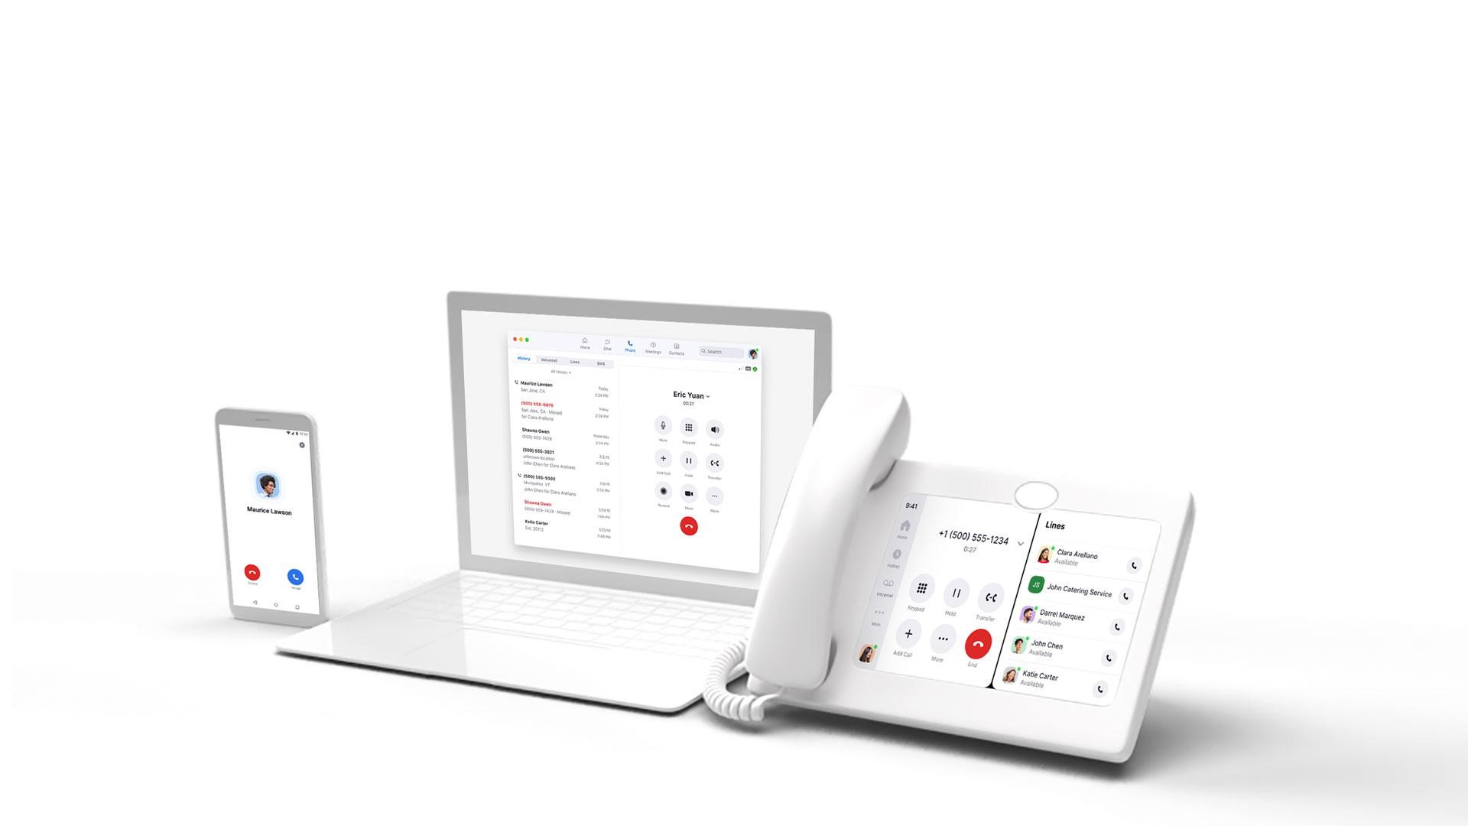
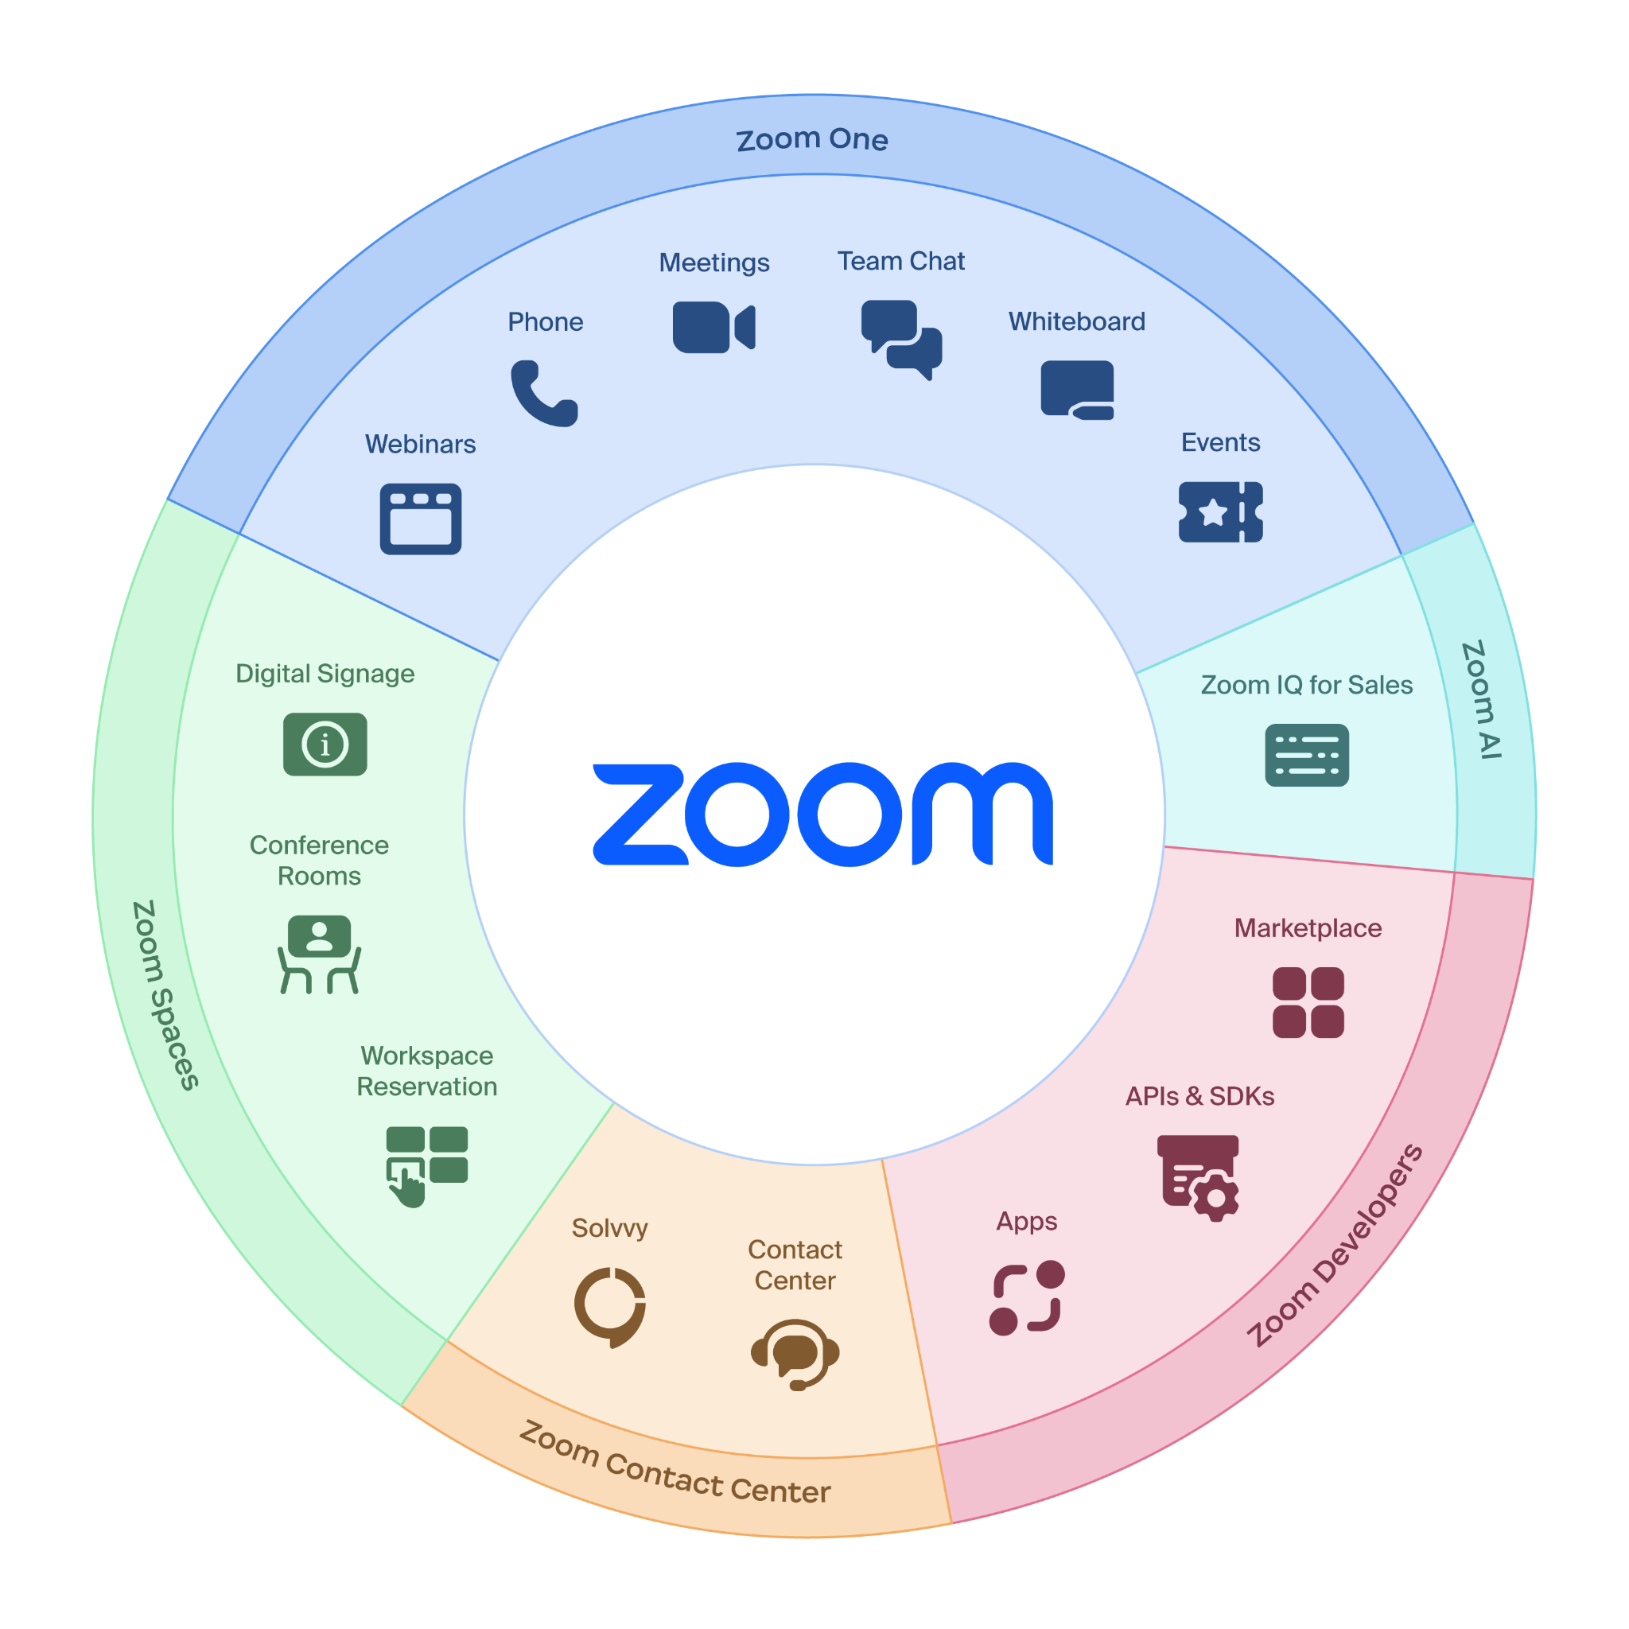
Power of the Zoom Platform
www.nuwave.com
©2023 NuWave Communications or its licensors. All Rights Reserved. Third-party marks and logos displayed are the trademarks of their respective owners.
Notes:
The Zoom platform empowers companies to make their #1 asset base - their people - extremely productive and happy - with equal opportunity for success. We keep information flowing across teams, time zones and projects, and give people the flexibility to work in ways they prefer. Make no mistake. The Zoom of today, is MUCH MORE than meetings. We are a platform with multi-faceted capabilities that will be where the employee and where they spend their work day.
This goes beyond Zoom itself. Yes, we provide meetings, chat, webinar, events, rooms, phone and contact center. On top of all of that, we allow for the integration of developer solutions and tools further extends the reach of our platform with APIs, our SDK’s, Zoom Apps and marketplace. Zoom capabilities can be incorporated just about everywhere.

Slide 6
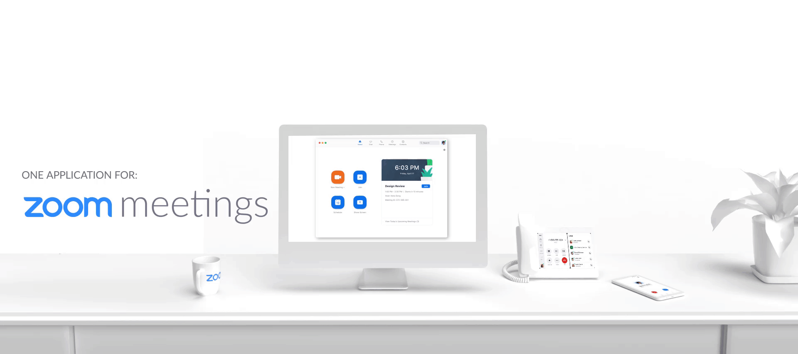

The Power of One
Reduce the complexity in your telecom portfolio and enable users to move effortlessly between:
One application running on one platform all delivered on a single core architecture.

Slide 7


Capabilities
Modern Phone Solution
Centralized Management
Secure & Reliable
Robust Hardware Ecosystem
Full-featured Cloud PBX
Domestic & International PSTN, Seamless workflow with Zoom Meetings
Single point of administration, call detail reporting, analytics & monitoring
QoS delivered by an adaptive rate codec, End-to-end encryption (beta), globally distributed datacenters, secure HD voice
Broad set of hardware options from handsets to analog devices and infrastructure.
www.nuwave.com
©2023 NuWave Communications or its licensors. All Rights Reserved. Third-party marks and logos displayed are the trademarks of their respective owners.
Notes:
Zoom Phone is an cloud-based phone system that is seamlessly integrated with Zoom Meetings.
Consolidate and manage your company-wide communications requirements from a single all-in-one solution
Your staff only needs to be trained to use a single app - lowering your support burden
Includes support for overhead campus and classroom paging systems
Supports 256-bit AES encryption to protect the privacy of your staff and students
Enhanced Emergency Services calling and reporting ensure quick, safe, and prompt responses to urgent situations when they arise.

Slide 8



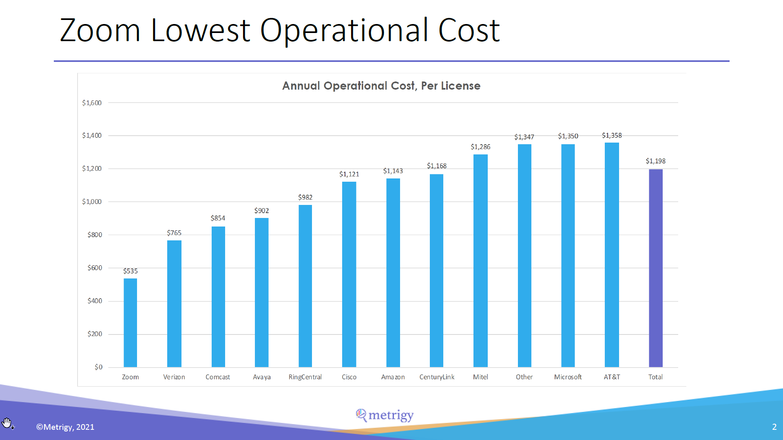
Standardize and Lower Your Costs
24.3%
Average savings with switching to Zoom for
10K employee organization
over 4 years
Metrigy Research, 2021
© 2021 Zoom Video Communications, Inc.
8
Notes:
We worked with third party analyst - Metrigy - to build a cost savings model to demonstrate the cost savings that can be achieved by standardizing on Zoom. The results show that the average savings for 10K employee rollout when comparing Zoom with four different competitors over a 4-year period using our cost model: 24.3%.
Metrigy Research, March 2021
The 64% operational cost savings that we use in the Zoom Phone vs MS Teams Calling assets comes from a March 2020 Nemertes (now called Metrigy) study on Workplace Collaboration and Contact Center.
Operational Cost was calculated based on the following components:
IT staff
Licensing/subscription
Equipment maintenance
Managed services
User training
IT training
WAN
PSTN access
Power

Slide 9

ZOOM 101: Phone Features
Elevate call to meeting
Transfer incoming calls to meetings
Dial by name directory
Call recording
Call Monitoring
Modern Phone Solution
Video mail
Exec/
admin line appearance + delegation
Set up work hours
Voice message transcribing
Intercom
Call Flip move calls between devices
Move mobile app calls across Wifi/ data and carrier
Call masking / privacy
Shared voicemail
Compliance features
Full-featured cloud PBX
Modernized, intuitive usability
See: All ZOOM VoIP Features for more info.
www.nuwave.com
©2023 NuWave Communications or its licensors. All Rights Reserved. Third-party marks and logos displayed are the trademarks of their respective owners.
Notes:
Zoom Phone is an cloud-based phone system that is seamlessly integrated with Zoom Meetings.
Consolidate and manage your company-wide communications requirements from a single all-in-one solution
Your staff only needs to be trained to use a single app - lowering your support burden
Includes support for overhead campus and classroom paging systems
Supports 256-bit AES encryption to protect the privacy of your staff and students
Enhanced Emergency Services calling and reporting ensure quick, safe, and prompt responses to urgent situations when they arise.

Slide 10




















Example Zoom Phone Customers
ç√
ç√
www.nuwave.com
©2023 NuWave Communications or its licensors. All Rights Reserved. Third-party marks and logos displayed are the trademarks of their respective owners.
Notes:
An example of some of our key Zoom Phone customers. As you can see there are several name brands across various industries and vertical markets

Slide 11


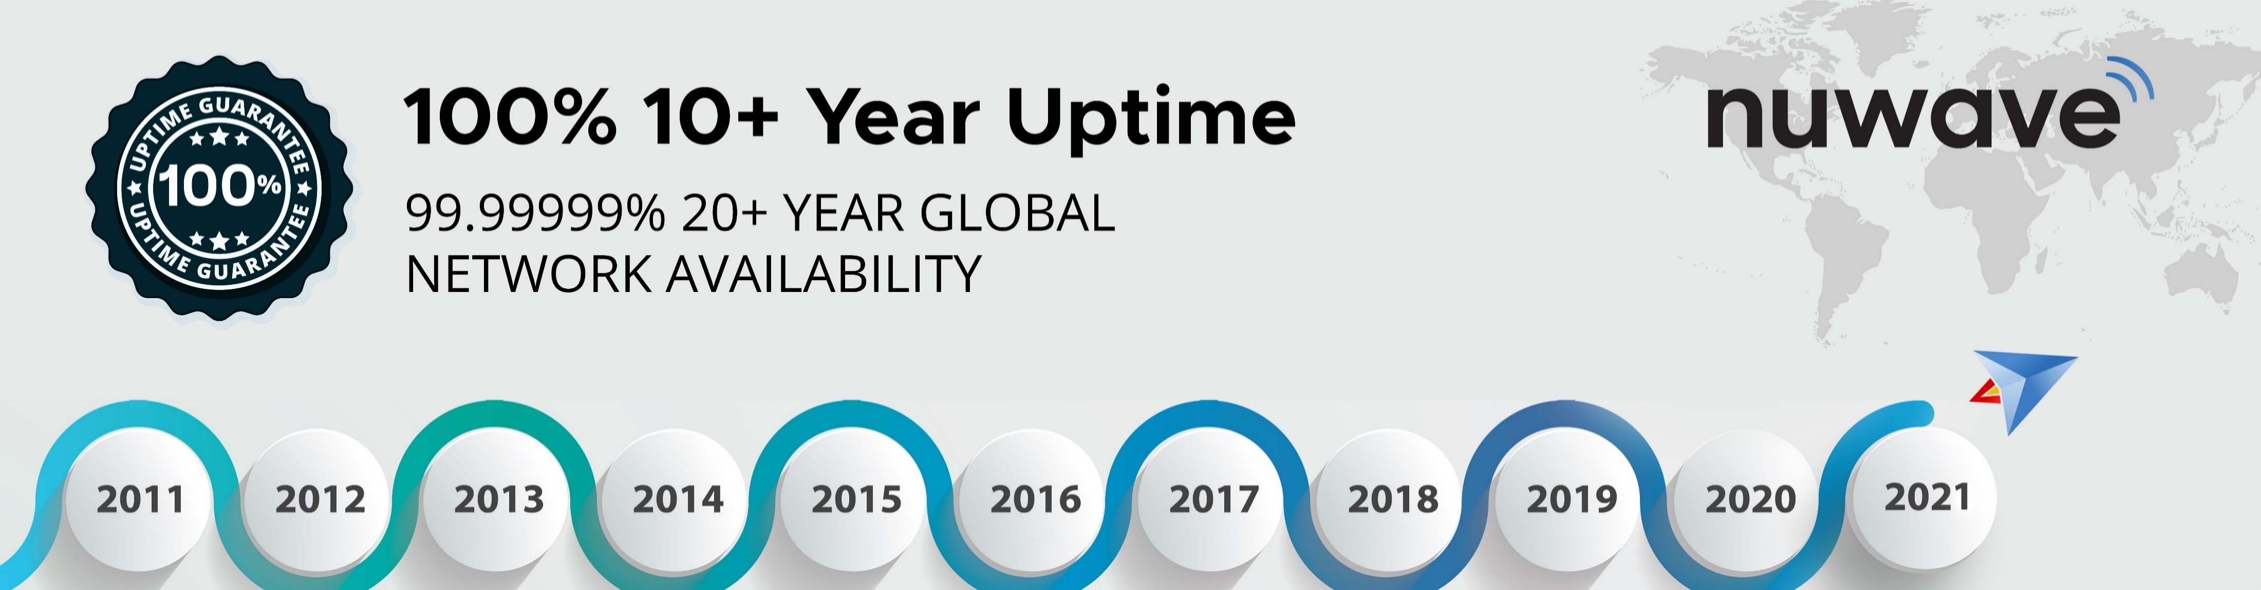
Our Network
SETTING NEW STANDARDS
Delivering Enterprise Voice for 10+ years without a customer facing service interruption
THE STRENGTH OF THE NETWORK
Carrier Grade Infrastructure.
Global Coverage – North America, EMEA, APAC
1 to 1 Connect to Zoom Phone Exchange
Fraud Detection & Monitoring
Complete Redundancy:
- Equipment, Power, Cooling, Access & Storage
Future Proof World Class Technology
Disaster Plan support
Committed Quality of Service
www.nuwave.com
©2023 NuWave Communications or its licensors. All Rights Reserved. Third-party marks and logos displayed are the trademarks of their respective owners.

Slide 12



^{Global Network}
^{North America}
^{Europe}
^{Asia Pacific}
^{South America}
^{Oceania}
^{South Africa}
www.nuwave.com
©2023 NuWave Communications or its licensors. All Rights Reserved. Third-party marks and logos displayed are the trademarks of their respective owners.

Slide 13


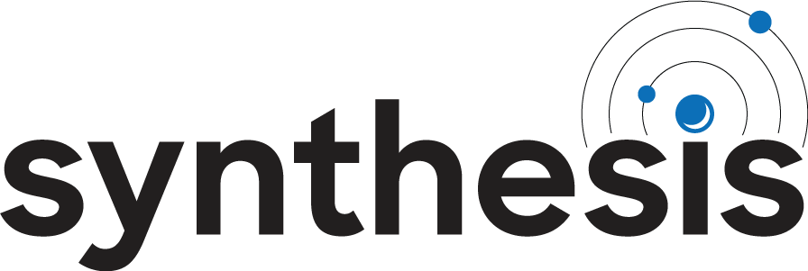

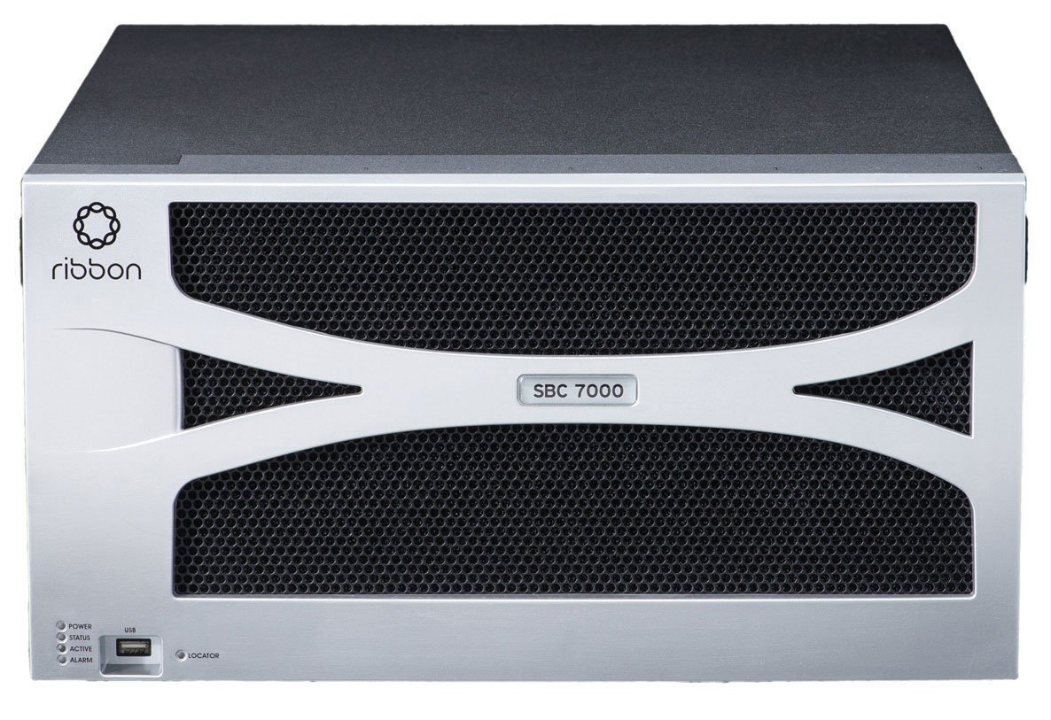




PSTN Tier 1 Providers
SYNTHESIS Intelligent Routing Database
SYNTHESIS Intelligent Routing Database
Encrypted TLS
over Public Internet
Encrypted TLS
over Public Internet
ZOOM
Phone
Users
ZOOM
Phone
Users
www.nuwave.com
©2023 NuWave Communications or its licensors. All Rights Reserved. Third-party marks and logos displayed are the trademarks of their respective owners.

Slide 14

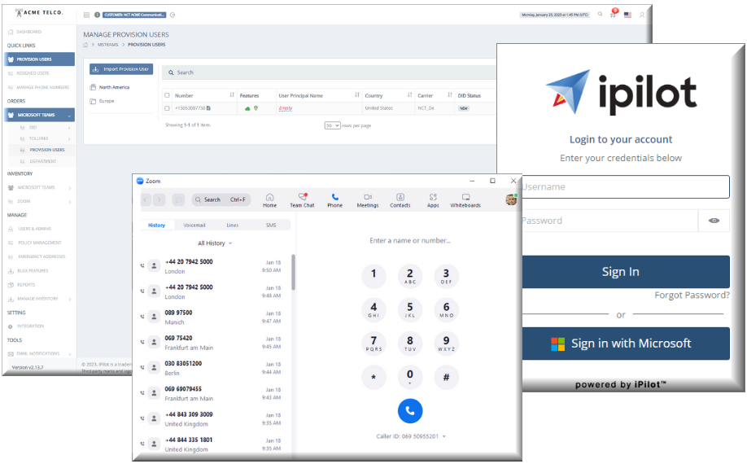

Communications Provisioning in Minutes, not Months
Unified
iPILOT™ offers a single pane of glass view and control of your entire global communications infrastructure.
Simplified
iPILOT™ simplifies the onboarding & tenant provisioning process into a single workflow that can be managed by non-technical personnel.
Fast
iPILOT™ reduces the time to market for Zoom Phone customers to minutes, not months.
www.nuwave.com
©2023 NuWave Communications or its licensors. All Rights Reserved. Third-party marks and logos displayed are the trademarks of their respective owners.
14

Slide 15





Overview
Solution
Benefits
Features
Diagrams
Pricing
Automation
Planning
Analytics
Administration
End-to-end communications management platform that is unmatched in the industry with its high level of service availability and support.
Number activation
Zoom Phone Configuration
Bulk Phone Number Assignment
MACD for Zoom Phone
Carrier Management
iPILOT Controlled Phone Number Assignment
Versatile Disaster Plans with flexibility to mitigate multiple forms of outages for customers. Built in PBX Assessment tools to efficiently plan your migrations.
PBX Assessment
Disaster Planning
Account Provisioning Staging
Phone Number Self-Service Porting
Full-service analytics and reporting features, including:
Quality of service reports
Call logs
Call Data Records
Call quality dashboard
Error Status reporting​
Versatile features built into iPILOT that help you manage your phone system for Microsoft Teams.
Call Forwarding
International Calling Restrictions
CNAM
Emergency Calling Services
Department Admin Role Based Access
www.nuwave.com
©2023 NuWave Communications or its licensors. All Rights Reserved. Third-party marks and logos displayed are the trademarks of their respective owners.

Slide 16


By connecting, automating, and orchestrating your global onboarding, provisioning, and management, you can do in minutes what previously took months and with significantly less cost and resources.
Unified Solution with iPILOT
Automated Provisioning Platform
Self Service Portal with Dashboard View – No Custom Code or Add Ins
Simplified & Automated – Planning, Provisioning, Onboarding, MACD Support
Number Porting, DID Management, International Calling Enablement
Dynamic E-911, Pre-Configure Disaster Plan, Carrier Level Call Forwarding
Capacity Planning with Real Time Graphs of Inbound & Outbound Calls
Carrier Management – Manage any Direct Routing from another provider
Automated Legacy PBX Assessments with Gap Analysis
Specialized Solutions – E-Fax, Overhead Paging, Call Recording, SMS
Managed Services – Local SBC, Gateway, Devices
Professional Services Available for Custom Call Flow & Auto Attendant Design
Voice Network Service Provider
Office/ Knowledge Worker
Network
Unified Solution with iPILOT
www.nuwave.com
©2023 NuWave Communications or its licensors. All Rights Reserved. Third-party marks and logos displayed are the trademarks of their respective owners.

Slide 17

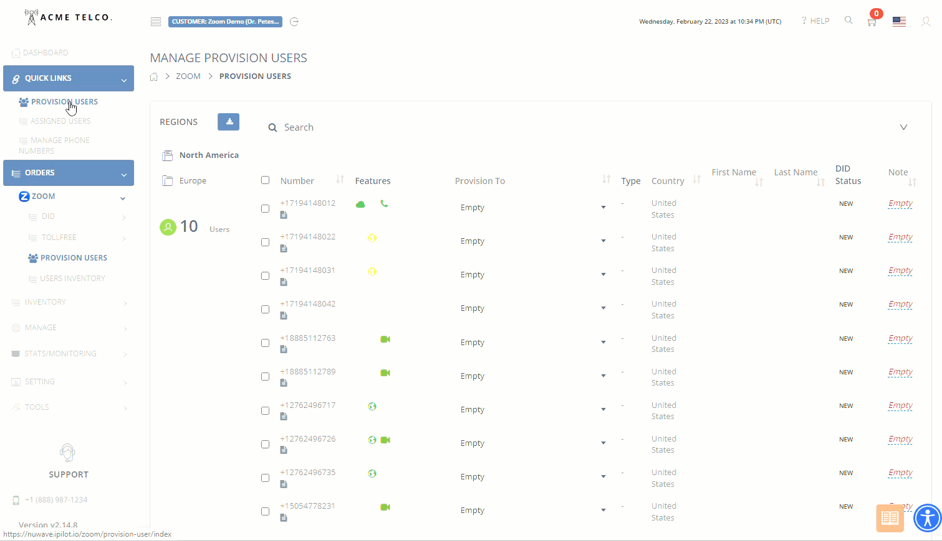
iPILOT & ZOOM: Direct Account Provisioning
Instantly Assign Numbers
From the iPILOT Portal, you can instantly assign phone numbers to:
Users
Auto Receptionists
Call Queues
www.nuwave.com
©2023 NuWave Communications or its licensors. All Rights Reserved. Third-party marks and logos displayed are the trademarks of their respective owners.
Notes:
Zoom Phone is an cloud-based phone system that is seamlessly integrated with Zoom Meetings.
Consolidate and manage your company-wide communications requirements from a single all-in-one solution
Your staff only needs to be trained to use a single app - lowering your support burden
Includes support for overhead campus and classroom paging systems
Supports 256-bit AES encryption to protect the privacy of your staff and students
Enhanced Emergency Services calling and reporting ensure quick, safe, and prompt responses to urgent situations when they arise.

Slide 18
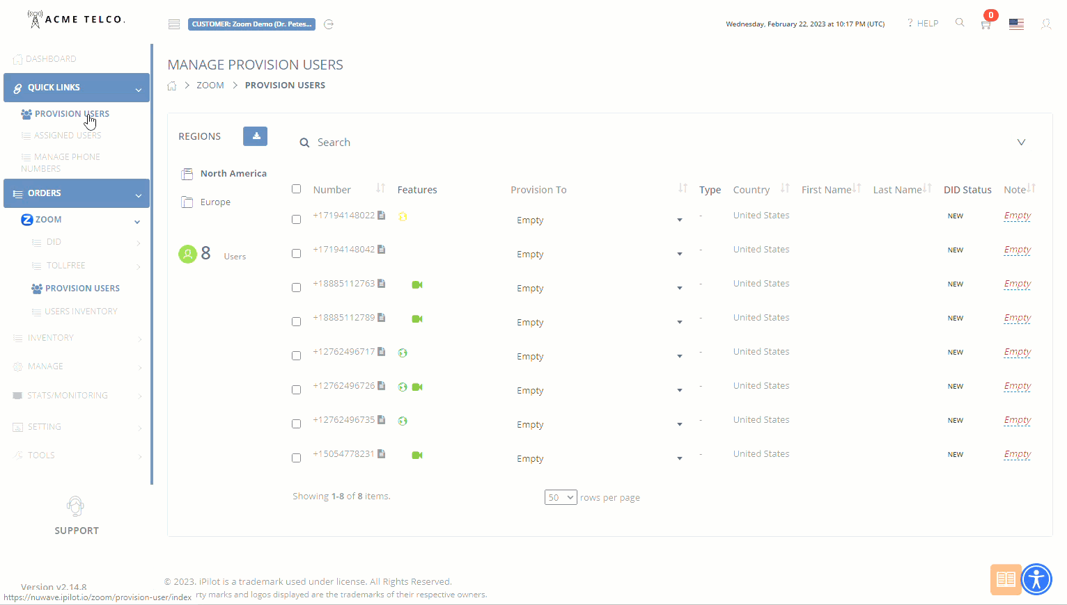
iPILOT & ZOOM: Peering Numbers
From the iPILOT Portal, you have the option to simply peer a number.
This adds the number to your ZOOM Phone Number inventory.
Assignments include:
User
Zoom Room
Common Area
Cisco/Polycom Room
Auto Receptionist
Call Queue
Shared Line Groups
www.nuwave.com
©2023 NuWave Communications or its licensors. All Rights Reserved. Third-party marks and logos displayed are the trademarks of their respective owners.
Notes:
Zoom Phone is an cloud-based phone system that is seamlessly integrated with Zoom Meetings.
Consolidate and manage your company-wide communications requirements from a single all-in-one solution
Your staff only needs to be trained to use a single app - lowering your support burden
Includes support for overhead campus and classroom paging systems
Supports 256-bit AES encryption to protect the privacy of your staff and students
Enhanced Emergency Services calling and reporting ensure quick, safe, and prompt responses to urgent situations when they arise.

Slide 19

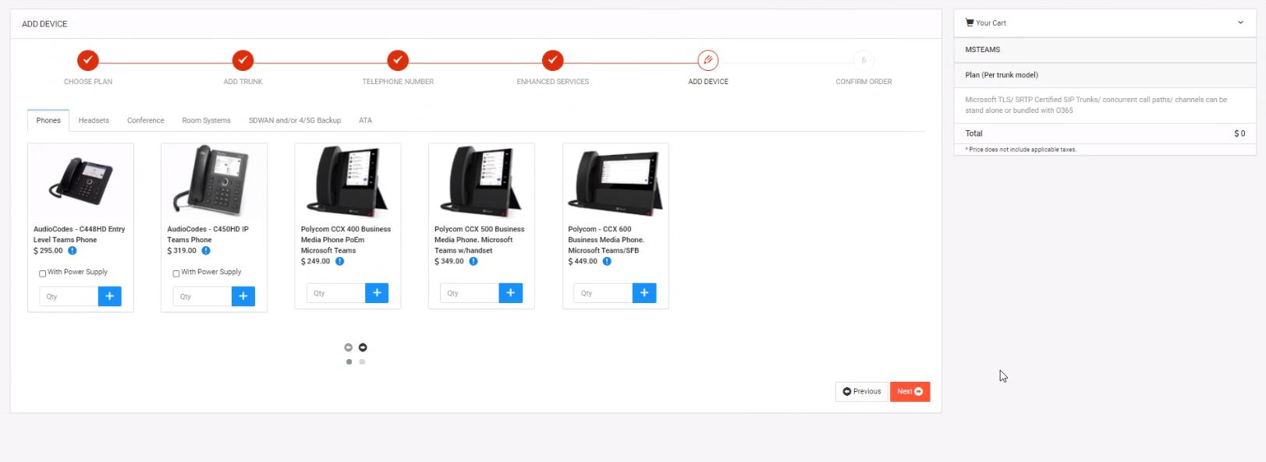








Automated Device Procurement
One Stop Shop For All Your Endpoint Requirements.
Option To Use Your Existing Buying Relationships.
Lab Tested By NUWAVE For Zoom
Handsets
Zoom Meeting Room
Board Rooms
Any Zoom Certified Endpoint
www.nuwave.com
©2023 NuWave Communications or its licensors. All Rights Reserved. Third-party marks and logos displayed are the trademarks of their respective owners.

Slide 20
An Innovative Solution
for Connecting Voice Services
Network as a Platform
Why SYNTHESIS
The SYNTHESIS™ platform is created to fill the gap and give speed to market for Carrier networks looking to offer their own Cloud Platform Carrier Voice services.
NUWAVE SYNTHESIS™ is a product that allows partners to bring their own SIP trunks to inter-connect into the NUWAVE carrier grade Network for ease of deployment for Zoom Voice.
NUWAVE does all the heavy lifting for partners by interfacing with the Zoom infrastructure and acting as the “front end” for partners networks, essentially meshing the NUWAVE carrier grade redundant network with the partners for the most optimal routing and resilient delivery of services.
Who is this for
Carrier Operators
Telecom License Partners
“NUWAVE is focused on the simplification, automation, and innovation that enhances our partners to be successful in the ever-changing marketplace. Our goal is to enable a scalable future for all that strive to be the best in their cloud communication service offerings.’’ Mark Bunnell - COO
www.nuwave.com
©2023 NuWave Communications or its licensors. All Rights Reserved. Third-party marks and logos displayed are the trademarks of their respective owners.

Slide 21






Why SYNTHESIS
The goal of the SYNTHESIS Platform is to simplify, speed up the onboarding process, reduce the associated integration CAPEX costs for the Service Provider and leverage existing Network as a Service from SYNTHESIS to provide deeper integrations, and overall, enable more Service Providers to easily integrate and offer voice services for cloud platform providers with less associated cost and complexity of handling of the relevant infrastructure.
Connectivity
Synthesis Provides Geo Redundant Global Network Coverage, with Pops in ASIA PACIFIC, EUROPE, North America, AFRICA and Latin Americas Regions.
Visibility
Synthesis provides Analytics with Encrypted SIP Analytics and IP Flow with quality assurance tools to support Partner Operations.
Scalability
Only pay for what you use without CapeX investment. SYNTHESIS platform provides maximum on-demand elasticity.
Automation
SYNTHESIS provides automated Routing through NUWAVE's Centralized Intelligent Routing Core, making it easy to connect and manage your service.
Security
Advanced security modules such as Carrier-Grade DDOS Mitigation, STIR/Shaken Framework, SIP Security with auto Detection & Blocking, and Toll Fraud Detection & Mitigation.
UC platform
Synthesis is connected to the Zoom network and partner using synthesis can easily and quicky launch and enable their own Cloud UC voice Offering.
www.nuwave.com
©2023 NuWave Communications or its licensors. All Rights Reserved. Third-party marks and logos displayed are the trademarks of their respective owners.

Slide 22

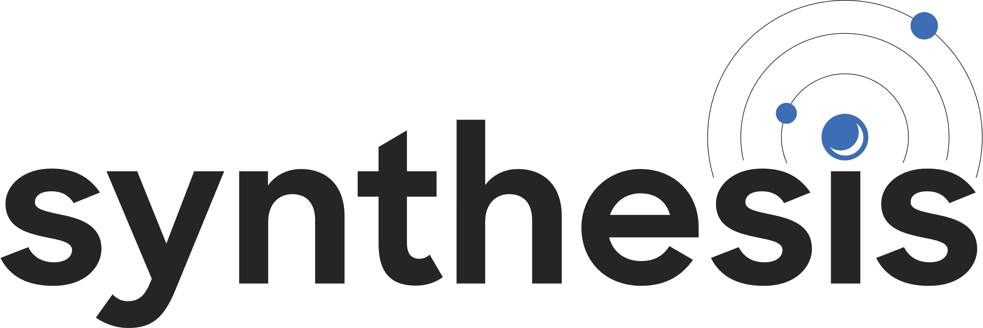





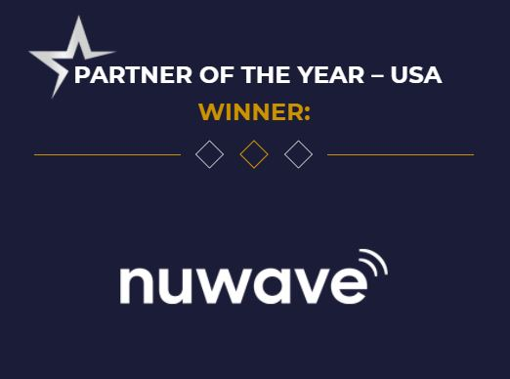

Award-Winning CPaaS Platform
API Integration
iPILOT offers a cloud platform as a service (CPaaS) to support the entire Zoom Calling lifecycle including migration, deployment, capacity management, support, analytics, and integration.
Complex Integrations Solved Through Innovation.
Simplifying the launch and scale of your UC Cloud Voice Offering.
Network as a Platform.
Geo-Redundant Global Network
SIP Connectivity
North America
Europe
Asia Pacific
Direct BGP
Peering
Carrier Grade Infrastructure
Carrier/Partner
Network
Certified, Carrier-Grade SBCs
High Availability,
Firewall Routers
Synthesis Centralized Intelligent Core Routing
Security, Analytics, and Fraud Protection Tools
Carrier-Grade DDOS Mitigation
STIR/Shaken
Framework
SIP Security with auto
Detection & Blocking
Encrypted SIP Analytics
IP Flow Analytics
Visibility & Quality Assurance Tools
Toll Fraud Detection & Mitigation
ISO 27001 Certification

Slide 23

How ISO 27001 Benefits NUWAVE Partners
NUWAVE has chosen to implement the most trusted global security certification, audited by independent bodies to ensure compliance with strict standards of practice, fostering trust and assurance.
the risk of cyberattacks…
by processing customer data securely according to best practices.
process and strategies…
by creating repeatable systems of accountable measurement.
system and business resiliency…
by designing and testing business continuity management.
to customer requirements…
by recording customer requirements and auditing compliance.
policy to comply with complex regulations…
by documenting regulatory obligation and auditing compliance.
trust, confidence and assurance…
because NUWAVE adheres to an international standard with measurable accountability to partners and customers.
Reduces
Improves
Increases
Aligns
Structures
Establishes
www.nuwave.com
©2023 NuWave Communications or its licensors. All Rights Reserved. Third-party marks and logos displayed are the trademarks of their respective owners.

Slide 24
Choose your solution
Unified Voice
Call Path
BYOC
$19.95/call path/mo.
$5.50/per user/mo.
$4.00/per user/mo.
N. America
750 pooled outbound min per CALL PATH
ADDITONAL minutes can be added
Unlimited ZOOM to ZOOM calls
EU
Inbound free
Outbound min. billed
See International, In-country Rates & Surcharges
Unlimited ZOOM to ZOOM calls
On Demand
Elastic Capacity
iPILOT platform included
Zoom Phone management, & automation platform
24/7 Support
Phone, Email, Web Chat, Teams
N. America
1000 Domestic minutes per user pooled
EU
Inbound free
Outbound min. billed
See International, In-country Rates & Surcharges
Unlimited ZOOM to ZOOM calls
All-in-One Solution
1 phone number & Dynamic 911 included.
iPILOT platform included
Zoom Phone management, & automation platform
On Demand
Capacity Scaling, Provisioning, and MACD Support
24/7 Support & Training
Phone, Email, Web Chat, Teams
Visibility & Control
ZOOM Phone and Carrier Services
Carrier Management
Bring your own carrier & manage your global voice network
Single Pane of Glass
Zoom Phone management, & automation platform
On Demand
Capacity Scaling, Provisioning, and MACD Support
24/7 Support & Training
Phone, Email, Web Chat, Teams
CURRENCY - USD
www.nuwave.com
©2023 NuWave Communications or its licensors. All Rights Reserved. Third-party marks and logos displayed are the trademarks of their respective owners.

Slide 25








60-Day Free Trial
Seeing is believing. In only a few minutes, enable yourself with the most industry disrupting tool in the market for Zoom Phone. Go to www.ipilot.io to get started.
We are here to answer any questions: sales@NUWAVE.com.
Proof of Concept
Included with our Free Trial:
Hands on Experience
Gain “Hands On” Experience with the iPILOT Self-Service Portal for Zoom Phone
Set-Up : Dedicated Solution Engineer for Standard Configurations
Duration: 60 Days - up to 10 Unified Voice Licenses w/DID’s
Location: US (Immediate Trunk & DID Availability)
Pre- Req’s: Zoom Phone Licenses
NUWAVE’s award-winning world class PSTN hosted Voice Network
iPILOT’s first in its class automated provisioning platform
Unified, Simple, and fast Zoom Phone Calling Experience
Combined with NUWAVE’s carrier grade SBCs, iPILOT delivers the best unified calling experience for Zoom Phone in the market today.
Unified Solution
Single Pane of Glass Management
Global Compliance
Enabled in Minutes
www.nuwave.com
©2023 NuWave Communications or its licensors. All Rights Reserved. Third-party marks and logos displayed are the trademarks of their respective owners.

Slide 26
Thankyou
www.nuwave.com
©2023 NuWave Communications or its licensors. All Rights Reserved. Third-party marks and logos displayed are the trademarks of their respective owners.

