Slide 1
SEPTEMBER 2023
www.nuwave.com
©2023 NuWave Communications or its licensors. All Rights Reserved. Third-party marks and logos displayed are the trademarks of their respective owners.

Slide 2
NUWAVE Communications
PROVEN EXPERIENCE & RELIABILITY
As a Global Voice Carrier, NUWAVE has 20+ years of experience delivering communications services to customers worldwide and developed iPILOT - an Award-Winning SaaS Platform to manage and deploy NUWAVE’s hosted Direct Routing Service for Microsoft Teams.
CLOUD VOICE
Carrier-Grade, Cloud Voice for BOTH Operator Connect and Direct Routing
TEAMS SMS
Send Texts, images and more with Business Texting for MS TEAMS
FAX INTEGRATIONS
On-Prem and Cloud Fax Integrations for your Cloud Voice Solution
iPILOT AUTOMATION
First in class, voice automation, provisioning, and management platform
CALL RECORDING
Compliance Call Recording with AI integrations and scripting
ANALOG INTEGRATION
Whether you have on-prem or analog devices, iPILOT has solutions for your needs
Why NUWAVE?
No Onsite Hardware, reduced CAPEX. Only an Internet Connection is Required.
1 to 1 Connect to Microsoft via Azure Peering Services
Deployment Support with dedicated Porting and Engineering Specialists
Reduce Deployment Costs and Timelines by using the iPILOT Self-Service Portal
A Few of Our Partners:
nuwave.com NuWave Communications Confidential and Proprietary
www.nuwave.com
©2023 NuWave Communications or its licensors. All Rights Reserved. Third-party marks and logos displayed are the trademarks of their respective owners.

Slide 3
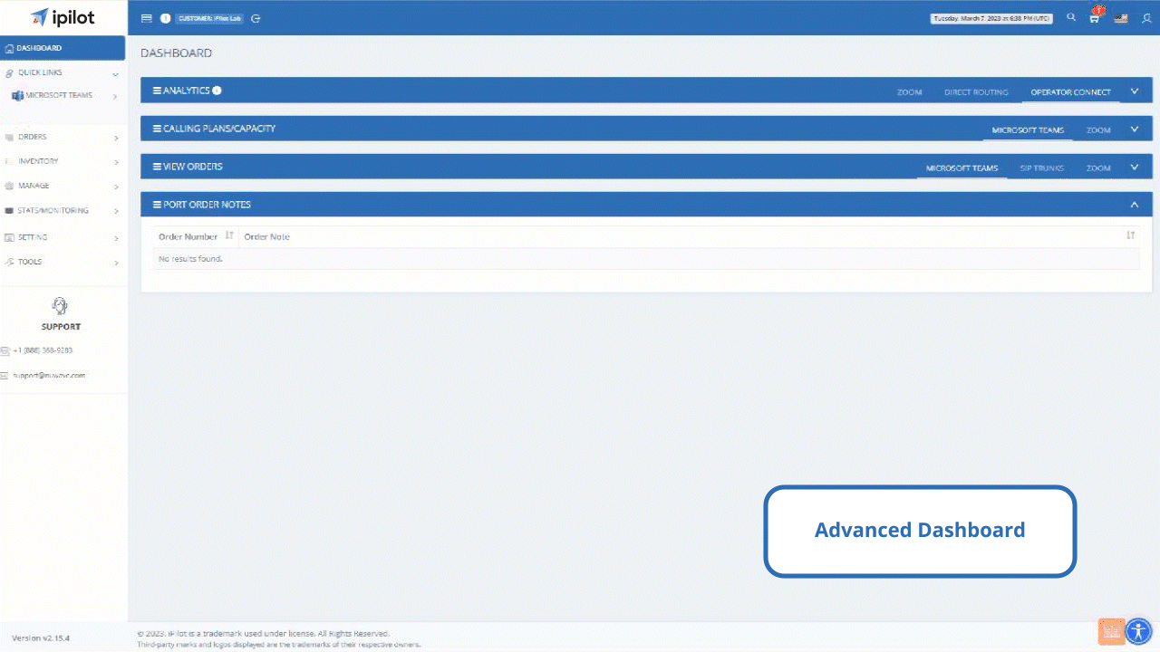
An Advanced Microsoft Teams
Management
Platform
Easy to manage,
White-label ready
iPILOT is a cloud-based platform that delivers comprehensive provisioning and lifecycle management capabilities for Microsoft Teams users.
iPILOT enables efficient deployment of Microsoft Teams & SIP through quick provisioning, capacity management and analytics for enterprises, carriers, and cloud service providers
www.nuwave.com
©2023 NuWave Communications or its licensors. All Rights Reserved. Third-party marks and logos displayed are the trademarks of their respective owners.

Slide 4
Migration
Planning
Automation
Analytics
Migration tools
Migration
Migration Tools
Easy to use Migration tools for Migrating from or to different systems.
Legacy PBX to Microsoft Teams
From Direct Routing to Operator Connect
Operator Connect to Direct Routing
Planning
Automation
Analytics
www.nuwave.com
©2023 NuWave Communications or its licensors. All Rights Reserved. Third-party marks and logos displayed are the trademarks of their respective owners.

Slide 5
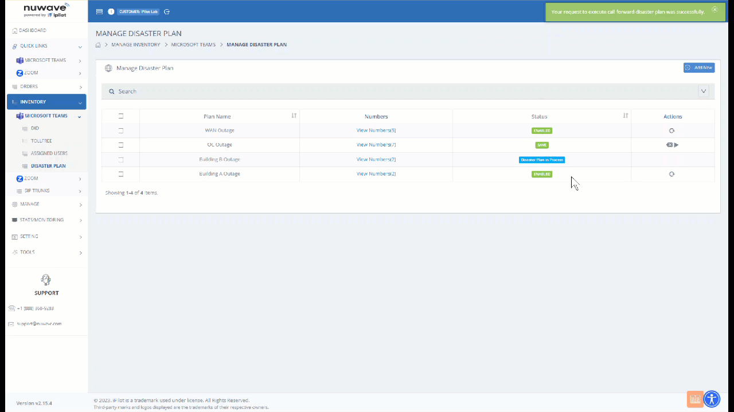
Migration
Planning
Automation
Analytics
Disaster Planning:
Migration
Planning
Versatile Disaster Plans with flexibility to mitigate multiple forms of outages for customers. Built in PBX Assessment tools to efficiently plan your migrations.
PBX Assessment
Disaster Planning
Account Provisioning Staging
Phone Number Self-Service Porting
Planning
Automation
Analytics
www.nuwave.com
©2023 NuWave Communications or its licensors. All Rights Reserved. Third-party marks and logos displayed are the trademarks of their respective owners.

Slide 6
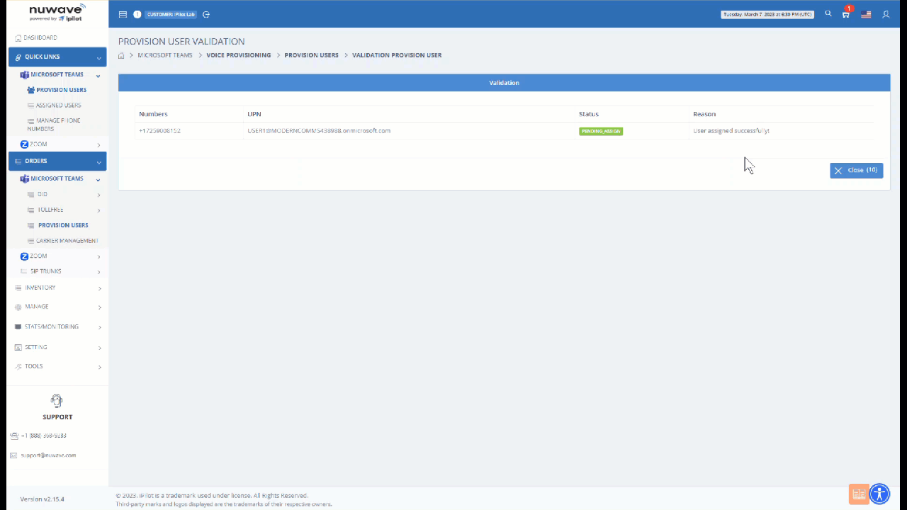
Migration
Planning
Automation
Analytics
Provisioning:
Migration
Automation
End-to-end communications management platform that is unmatched in the industry with its high level of service availability and support.
Number activation
Direct Routing Tenant Configuration
Bulk Phone Number Assignment
MACD for Teams Voice​
Carrier Management
iPILOT Controlled Operator Connect
Phone Number Assignment
Planning
Automation
Analytics
www.nuwave.com
©2023 NuWave Communications or its licensors. All Rights Reserved. Third-party marks and logos displayed are the trademarks of their respective owners.

Slide 7
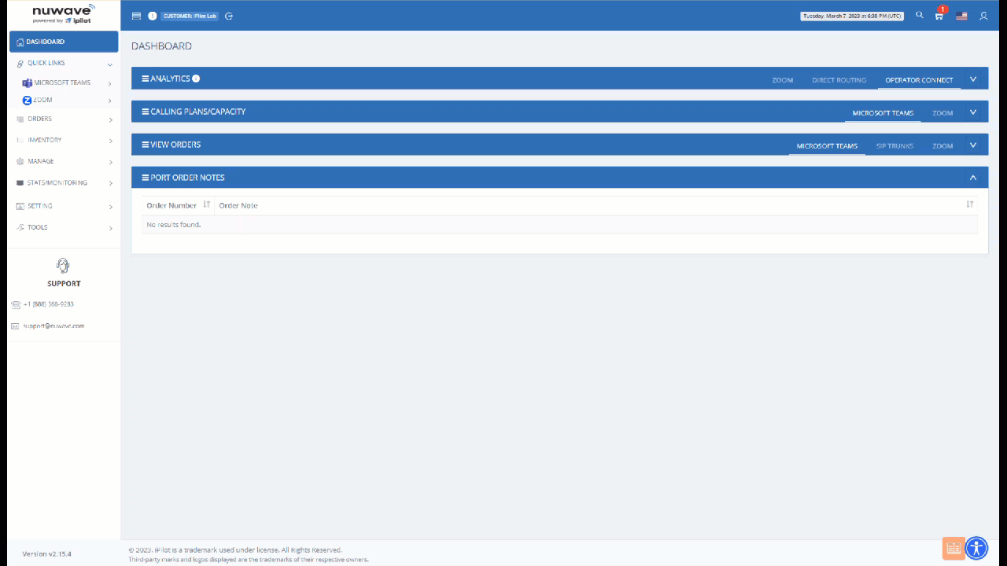
Migration
Planning
Automation
Analytics
Analytics:
Migration
Analytics
Full-service analytics and reporting features, including:
Quality of service reports
Call logs
Call Data Records
Call quality dashboard
Error Status reporting​
Planning
Automation
Analytics
www.nuwave.com
©2023 NuWave Communications or its licensors. All Rights Reserved. Third-party marks and logos displayed are the trademarks of their respective owners.

Slide 8
Enable Free Trials
In only a few minutes, your customers can self-enable a specified, time-limited POC of your Microsoft Teams Voice or Zoom offer.
Enable your customers and partners with the most industry disrupting tool in the market.
Proof of Concept
What you can include in your Free Trial:
iPILOT Benefits
Set-Up : Automated Provisioning including Self-Activation
Duration: Free Trial periods can be customized as needed
Carriers’ Voice: Ability to enable Free Trials (Immediate Trunk & DID Availability)
Built for the Global Market: Multi-Lingual User Interface
Business Continuity: Extensive learning and knowledge base to leverage lower cost resources
Carrier Partner Voice Network
iPILOT’s first in its class automated provisioning platform
Unified, Simple, and fast Microsoft Teams, Zoom Phone or Webex Cloud Calling Experience
iPILOT delivers the best unified calling experience in the market today.
Unified Solution
Single Pane of Glass Management
Global Compliance
Enabled in Minutes
nuwave.com NuWave Communications Confidential and Proprietary
www.nuwave.com
Sales@nuwave.com
©2023 NuWave Communications or its licensors. All Rights Reserved. Third-party marks and logos displayed are the trademarks of their respective owners.

Slide 9
Thankyou
www.nuwave.com
Sales@nuwave.com
©2023 NuWave Communications or its licensors. All Rights Reserved. Third-party marks and logos displayed are the trademarks of their respective owners.

