Slide 1
The New Hybrid Work Model
The need for a unified experience
The Surge in Video Meetings
Video conf surged in 2020
In 2021, video conferencing became the must-have UC&C application to support hybrid work. video is a more proven way to collaborate effectively
Unified Communications & Collaboration (UC&C) Voice and Messaging
Demands to offer multiple means of communicating—calls, voice, video meetings, and enterprise-grade messaging.
Team Collaboration as the New Dial Tone in the COVID Era
Many front-line worker jobs depend on team collaboration. Remote knowledge workers rely heavily on team collaboration tools
Intelligent UC&C Platform with team collaboration
Transition from analog features to true intelligent communications platforms. Seamless Modalities and Full Functionality
www.nuwave.com
©2023 NuWave Communications or its licensors. All Rights Reserved. Third-party marks and logos displayed are the trademarks of their respective owners.
1
Notes:
Video conferencing surged to the forefront in 2020, as people around the globe had to work from home. In 2021, video conferencing became the must-have UC&C application to support hybrid work. It isn’t that meetings were not held with video conferencing in the past, but that for so many use cases, video is a more proven way to collaborate effectively. UC&C platform’s demand is that providers can offer multiple means of communicating—calls, voice, video meetings, and enterprise-grade messaging Many front-line worker jobs depend on team collaboration, which was the case before COVID. How many knowledge workers are also depending on team collaboration because of the lack of being together with co-workers? transition from analog features that merge together to true intelligent communications platforms. Seamless Modalities and Full Functionality
General Help
For other tips on how best to use this template, see the instructional slides toward the end of this deck.
Icons
Our icon library is at the end of this deck.
Beyond a Unified Client to a Unified Experience

Slide 2
Future of Work
Gartner Research Report
Demands:
39%
75%
Seamless modalities and full functionality
Robust analytics
Automation
Intelligence
Easy processes
UC&C + contact center
Voice cloud migrations & hybrid cloud
Team collaboration - the only way to make remote work a success
APIs and new experiences
Marketplace for integrations
Knowledge workers surveyed said they may leave their job if they're expected to fully return in person
Hybrid/remote workers have increased expectations around workplace flexibility
www.nuwave.com
©2023 NuWave Communications or its licensors. All Rights Reserved. Third-party marks and logos displayed are the trademarks of their respective owners.
2
Notes:
Changing Dot Colors
Click and drag to select dots. Use the paint bucket tool to fill with Zoom blue.
Research by Gartner confirms that: A recent report found that 75% of hybrid/remote workers have increased expectations around workplace flexibility. Further, 39% of knowledge workers surveyed said they may leave their job if they're expected to fully return in person.

Slide 3
More than meetings, Zoom is focused on full UC&C platform
“
I truly believe that a flexible workforce is something that employers will need to accommodate in order to have the best shot to attract and retain talent. As leaders, we need to consider what is possible and how we can best position our colleagues and organization for success. To help employers meet workers where they are, Zoom is building products that bridge the remote and in-office worlds. We've innovated our way from a video conferencing offering to a comprehensive communications platform that powers every type of organization.”
Eric S. Yuan
Founder & CEO
Zoom
www.nuwave.com
©2023 NuWave Communications or its licensors. All Rights Reserved. Third-party marks and logos displayed are the trademarks of their respective owners.
3
Notes:
How to Replace Image Placeholder
1. Identify placeholder
2. Right Click > Replace Image
3. Find image and click Open
4. If needed, use the Crop tool to reposition or resize the image within the placeholder
General Help
For other tips on how best to use this template, see the instructional slides toward the end of this deck.

Slide 4
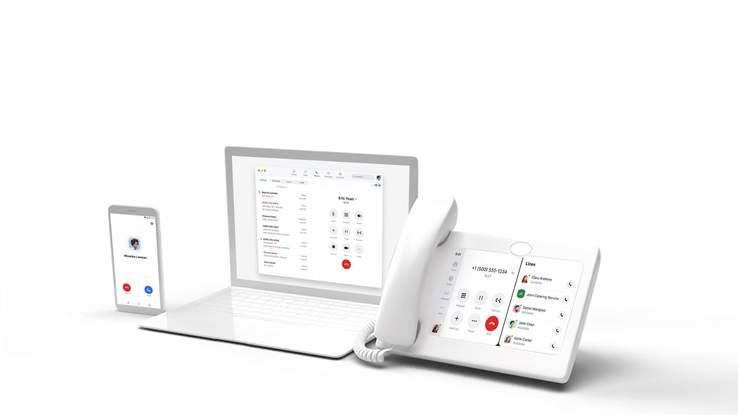
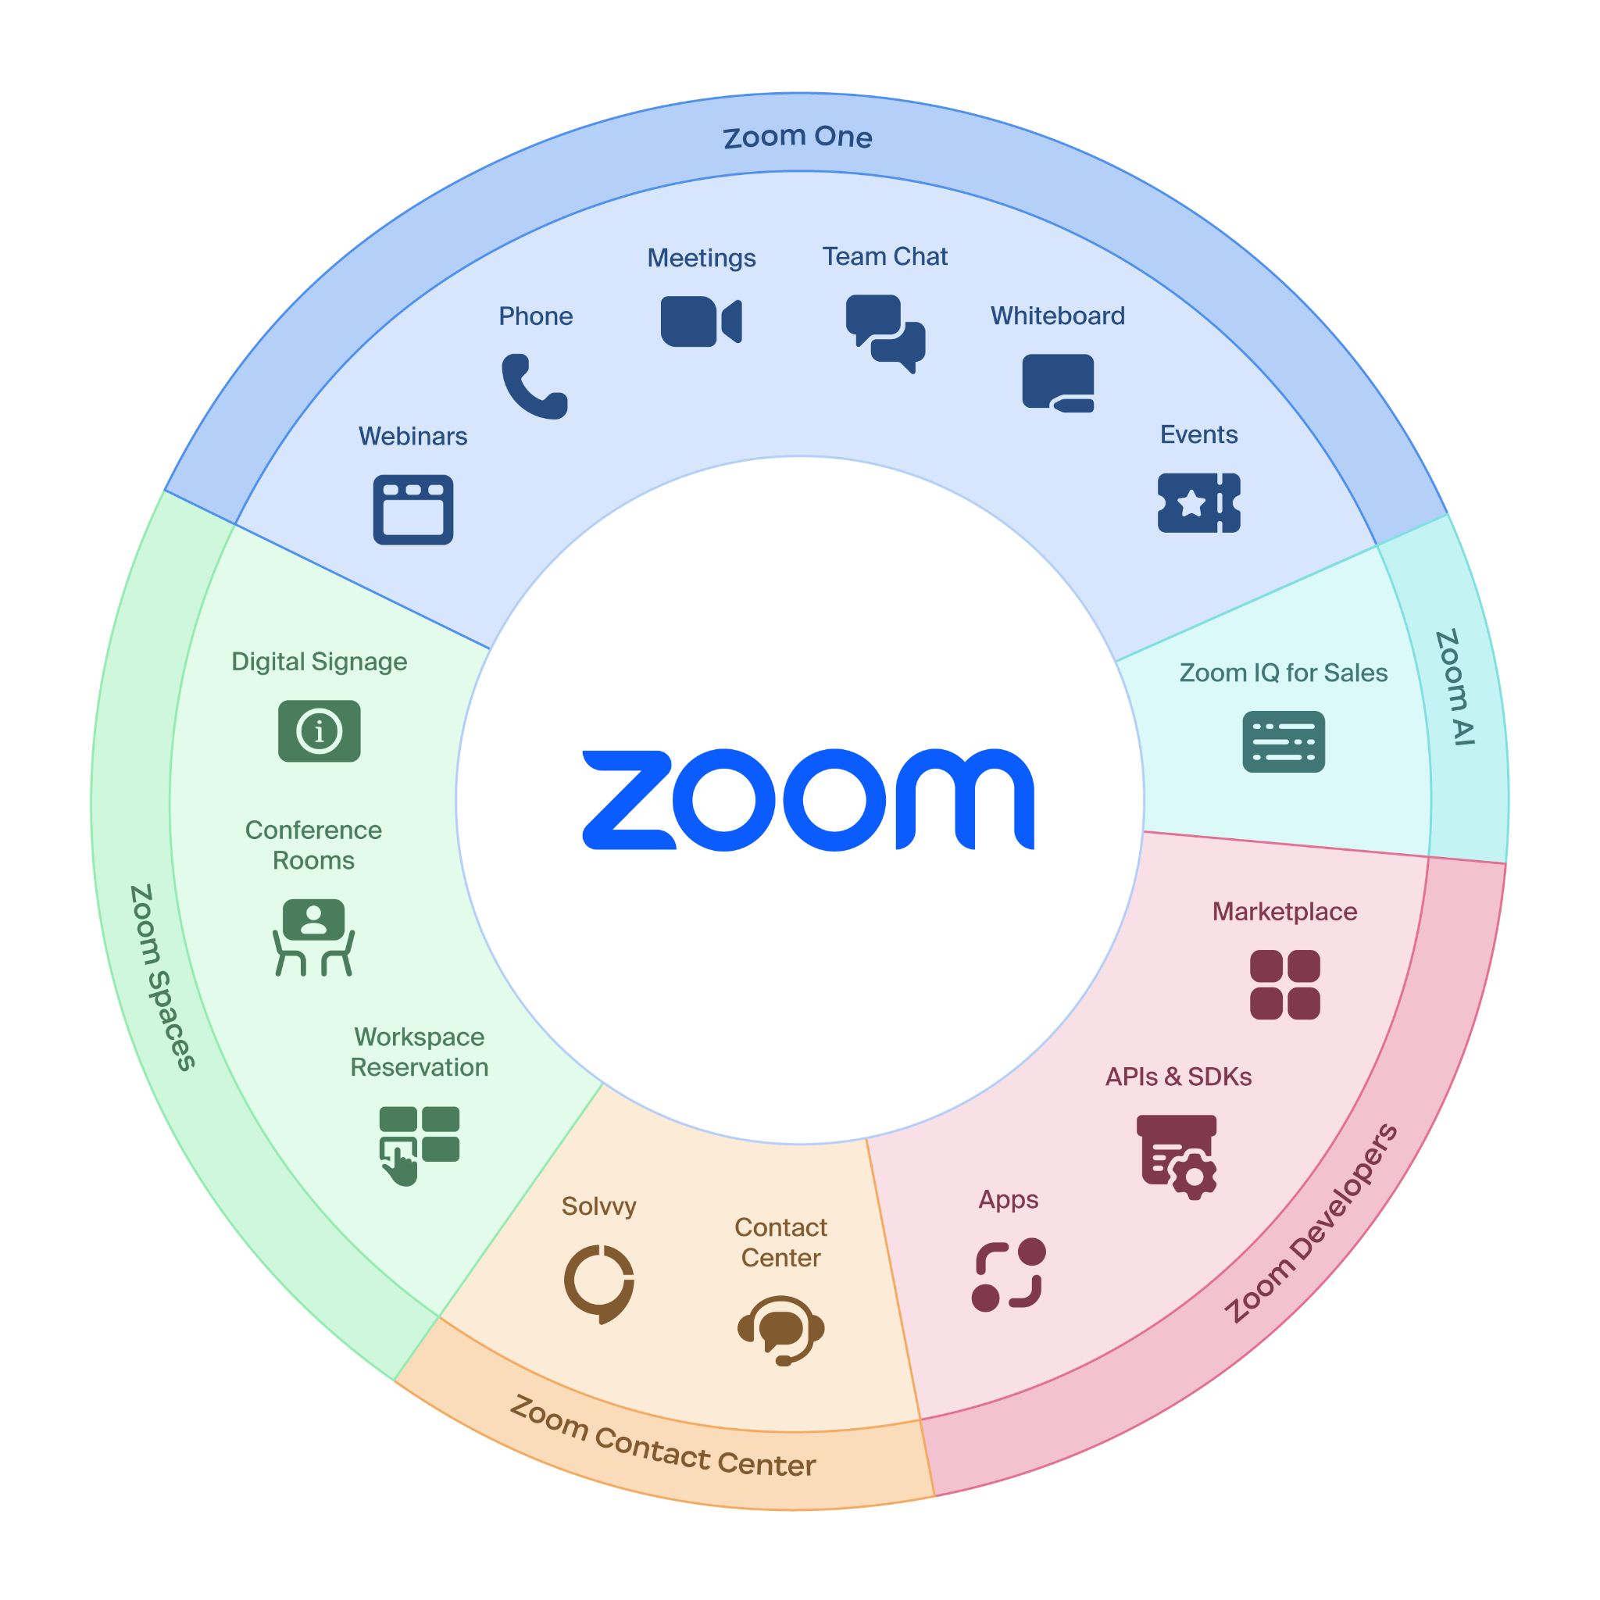
Power of the Zoom Platform
www.nuwave.com
©2023 NuWave Communications or its licensors. All Rights Reserved. Third-party marks and logos displayed are the trademarks of their respective owners.
Notes:
The Zoom platform empowers companies to make their #1 asset base - their people - extremely productive and happy - with equal opportunity for success. We keep information flowing across teams, time zones and projects, and give people the flexibility to work in ways they prefer. Make no mistake. The Zoom of today, is MUCH MORE than meetings. We are a platform with multi-faceted capabilities that will be where the employee and where they spend their work day.
This goes beyond Zoom itself. Yes, we provide meetings, chat, webinar, events, rooms, phone and contact center. On top of all of that, we allow for the integration of developer solutions and tools further extends the reach of our platform with APIs, our SDK’s, Zoom Apps and marketplace. Zoom capabilities can be incorporated just about everywhere.

Slide 5
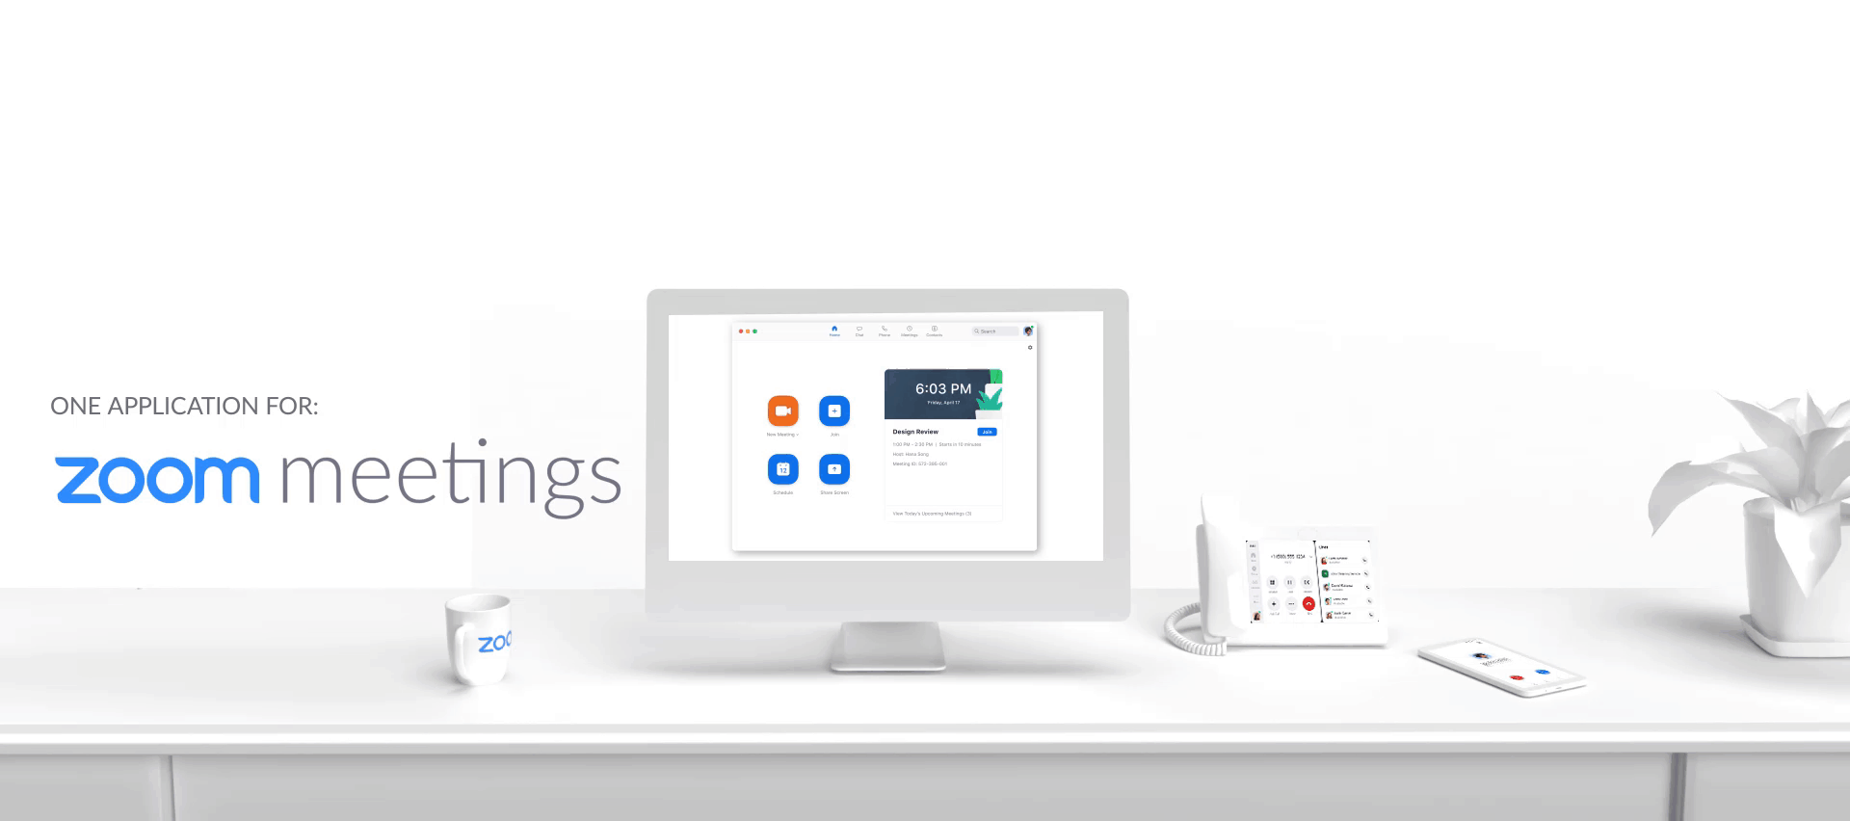
The Power of One
Reduce the complexity in your telecom portfolio and enable users to move effortlessly between:
One application running on one platform all delivered on a single core architecture.

Slide 6
Capabilities
Modern Phone Solution
Centralized Management
Secure & Reliable
Robust Hardware Ecosystem
Full-featured Cloud PBX
Domestic & International PSTN, Seamless workflow with Zoom Meetings
Single point of administration, call detail reporting, analytics & monitoring
QoS delivered by an adaptive rate codec, End-to-end encryption (beta), globally distributed datacenters, secure HD voice
Broad set of hardware options from handsets to analog devices and infrastructure.
www.nuwave.com
©2023 NuWave Communications or its licensors. All Rights Reserved. Third-party marks and logos displayed are the trademarks of their respective owners.
Notes:
Zoom Phone is an cloud-based phone system that is seamlessly integrated with Zoom Meetings.
Consolidate and manage your company-wide communications requirements from a single all-in-one solution
Your staff only needs to be trained to use a single app - lowering your support burden
Includes support for overhead campus and classroom paging systems
Supports 256-bit AES encryption to protect the privacy of your staff and students
Enhanced Emergency Services calling and reporting ensure quick, safe, and prompt responses to urgent situations when they arise.

Slide 7
Standardize and Lower Your Costs
24.3%
Average savings with switching to Zoom for 10K employee organization over 4 years
Metrigy Research, 2021
© 2021 Zoom Video Communications, Inc.
7
Notes:
We worked with third party analyst - Metrigy - to build a cost savings model to demonstrate the cost savings that can be achieved by standardizing on Zoom. The results show that the average savings for 10K employee rollout when comparing Zoom with four different competitors over a 4-year period using our cost model: 24.3%.
Metrigy Research, March 2021
The 64% operational cost savings that we use in the Zoom Phone vs MS Teams Calling assets comes from a March 2020 Nemertes (now called Metrigy) study on Workplace Collaboration and Contact Center.
Operational Cost was calculated based on the following components:
IT staff
Licensing/subscription
Equipment maintenance
Managed services
User training
IT training
WAN
PSTN access
Power

Slide 8
ZOOM 101: Phone Features
Elevate call to meeting
Transfer incoming calls to meetings
Dial by name directory
Call recording
Call Monitoring
Modern Phone Solution
Video mail
Exec/ admin line appearance + delegation
Set up work hours
Voice message transcribing
Intercom
Call Flip move calls between devices
Move mobile app calls across Wifi/ data and carrier
Call masking / privacy
Shared voicemail
Compliance features
Full-featured cloud PBX
Modernized, intuitive usability
See: All ZOOM VoIP Features for more info.
www.nuwave.com
©2023 NuWave Communications or its licensors. All Rights Reserved. Third-party marks and logos displayed are the trademarks of their respective owners.
Notes:
Zoom Phone is an cloud-based phone system that is seamlessly integrated with Zoom Meetings.
Consolidate and manage your company-wide communications requirements from a single all-in-one solution
Your staff only needs to be trained to use a single app - lowering your support burden
Includes support for overhead campus and classroom paging systems
Supports 256-bit AES encryption to protect the privacy of your staff and students
Enhanced Emergency Services calling and reporting ensure quick, safe, and prompt responses to urgent situations when they arise.

Slide 9
Example Zoom Phone Customers
ç√
ç√
www.nuwave.com
©2023 NuWave Communications or its licensors. All Rights Reserved. Third-party marks and logos displayed are the trademarks of their respective owners.
Notes:
An example of some of our key Zoom Phone customers. As you can see there are several name brands across various industries and vertical markets

