Slide 1
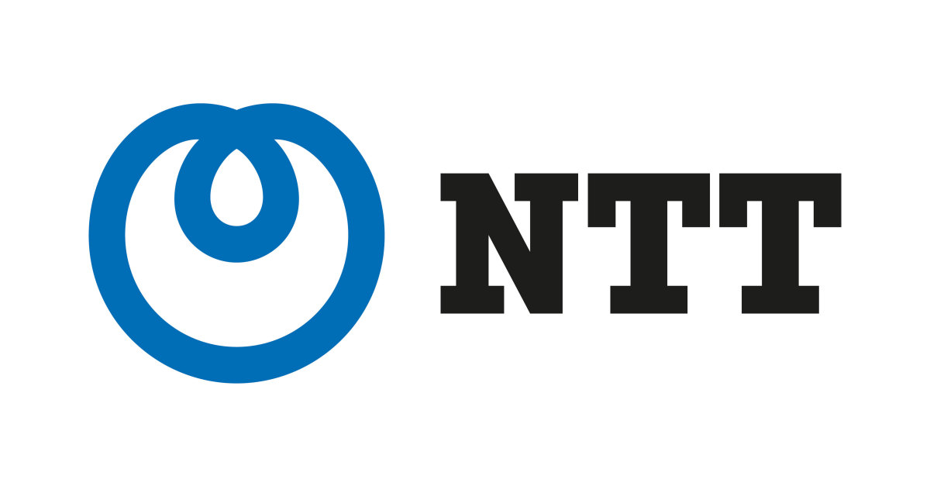
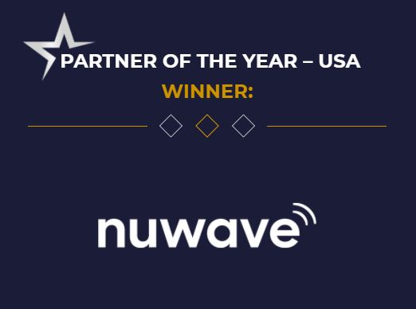
NUWAVE Communications
PROVEN EXPERIENCE & RELIABILITY
As a Global Voice Carrier, NUWAVE has 20+ years of experience delivering communications services to customers worldwide and developed iPILOT - an Award-Winning SaaS Platform to manage and deploy NUWAVE’s hosted Zoom Phone Service.
CLOUD VOICE
Carrier-Grade, Cloud Voice for your
Zoom Phone Voice Service
SMS
Send Texts, images and more with Business Texting for Cloud OEMs
FAX INTEGRATIONS
On-Prem and Cloud Fax Integrations for your Cloud Voice Solution
iPILOT AUTOMATION
First in class, voice automation, provisioning, and management platform
CALL RECORDING
Compliance Call Recording with AI integrations and scripting
ANALOG INTEGRATION
Whether you have on-prem or analog devices, iPILOT has solutions for your needs
Why NUWAVE?
No Onsite Hardware, reduced CAPEX. Only an Internet Connection is Required.
1 to 1 Connect to Zoom Phone Services
Deployment Support with dedicated Porting and Engineering Specialists
Reduce Deployment Costs and Timelines by using the iPILOT Self-Service Portal
A Few of Our Partners:
nuwave.com NuWave Communications Confidential and Proprietary
www.nuwave.com
©2023 NuWave Communications or its licensors. All Rights Reserved. Third-party marks and logos displayed are the trademarks of their respective owners.

Slide 2
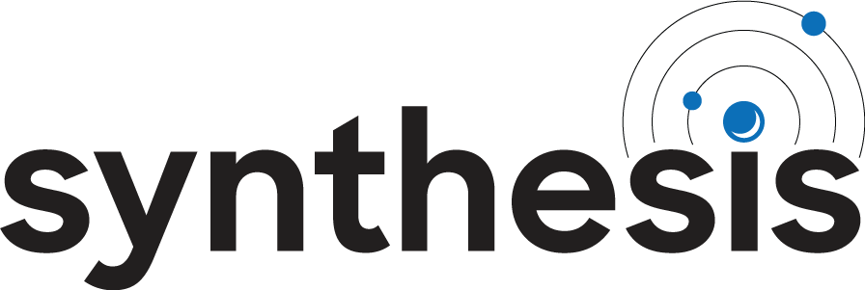
^{NA Location A}
^{Las Vegas, NV}
^{Europe Location A}
^{London England}
^{Europe Location B}
^{Frankfurt Germany}
^{APAC Location A}
^{China Hong Kong}
Easily Connect
Your Services to
Our Global Marketplace
^{Global Network}
^{North America}
^{Europe}
^{South America}
^{Oceania}
^{Africa}
^{APAC}
^{NA Location B}
^{Ashburn, VA}
^{Brazil (2 pops)}
^{Sao Paulo}
^{Africa (2 pops)}
^{Cape Town}
^{APAC Location B}
^{Australia Location B}
^{Singapore}
^{Australia Location A}
^{Sydney}
www.nuwave.com
©2022 NuWave Communications or its licensors. All Rights Reserved.
Third-party marks and logos displayed are the trademarks of their respective owners.

Slide 3
How NUWAVE's ISO Certifications Benefits NUWAVE Partners
NUWAVE has recently increased its security posture by adding 3 more ISO certifications to its existing ISO 27001 status. ISO 27017, 271018, and 27701 certifications are now also in place for meeting the NEW Industry standard for protecting Enterprise Cloud services that NUWAVE takes to market to customers and enables through its Partners.
NUWAVE has chosen to implement the most trusted global security certification, audited by independent bodies to ensure compliance with strict standards of practice, fostering trust and assurance.
the risk of cyberattacks…
by processing customer data securely according to best practices.
process and strategies…
by creating repeatable systems of accountable measurement.
system and business resiliency…
by designing and testing business continuity management.
to customer requirements…
by recording customer requirements and auditing compliance.
policy to comply with complex regulations…
by documenting regulatory obligation and auditing compliance.
trust, confidence and assurance…
because NUWAVE adheres to an international standard with measurable accountability to partners and customers.
Reduces
Improves
Increases
Aligns
Structures
Establishes
www.nuwave.com
©2023 NuWave Communications or its licensors. All Rights Reserved. Third-party marks and logos displayed are the trademarks of their respective owners.

